Slide 1
#Heritage alive!
Eivind Falk

Slide 2
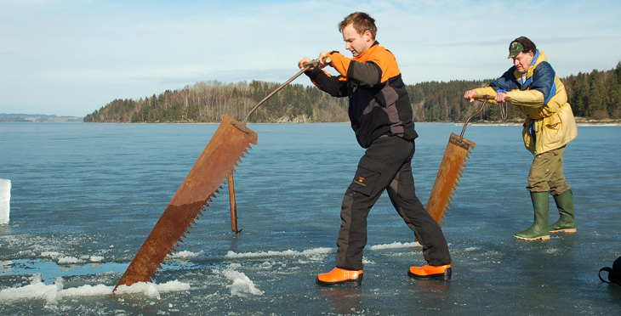
Themes
Methodological challenges working in the field
Sustainable development of ICH
Cultural industries
Common for the themes is that they should have a practical approach and describe the methodical challenges we meet as experts and NGOs in the field. Examples both of good practices and bad practices are welcomed in order to share reflections and experiences between the NGOs and experts.

Slide 3
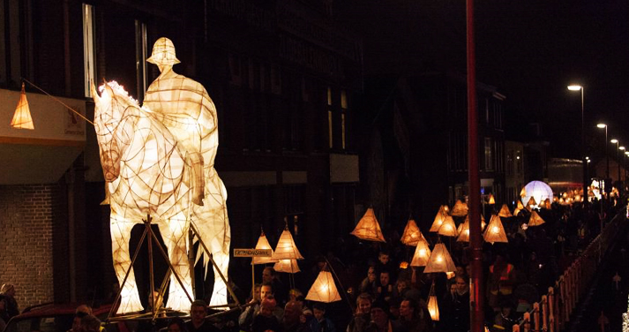
Editorial frames
1. The articles should be around 2000 words
2. The author is responsible for washing the text for misspellings before passing it to the board. A text characterized by misspellings and grammatical errors will be returned to the author.
3. When the article is ready and approved by the board, the author will be asked to write a summary which can be translated into either French or English.

Slide 4
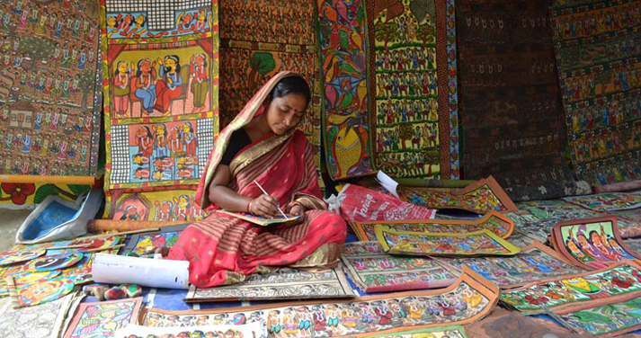
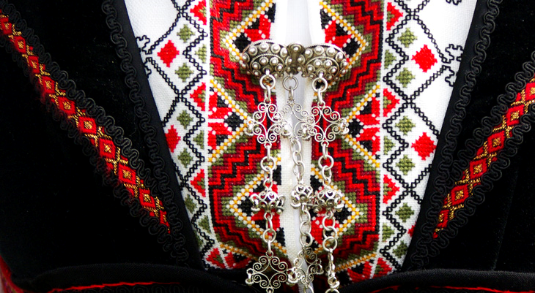
#Heritage Alive
http://www.ichngoforum.org/category/heritage-alive/

Slide 5
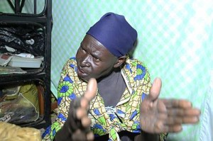
Members of the editorial board #Heritage alive!
Eivind Falk
Rajiv Trivedi
Emily Drani
Ananya Bhattacharya
Albert vd Zeijden
Salih Taner Serin
Valentina Zingari
Sumi Nam
Dr. V. Jayaran
Eva Romankova
Harriet Deacon
Joseph Ogieriakhi
Fanny Houët
Ki Leonce
Gabriele D
Severin Cachat

Slide 6
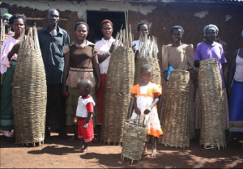
SYMPOSIUM in Windhoek
#Heritage alive!-Symposium for experts and NGOs
1st of December – 5.30 to 7.00pm:
A case of Koogere oral tradition in Uganda
-by Stephen Rwagweri
The Empaako Traditional Naming Practice in Uganda
-by Emily Drani

