Slide 1
Safeguarding culture and promoting Sustainable development
Sharing Best Practice at the
ICH NGO Forum, Paris
9.COM
23 November 2014
THE EXPERIENCE OF KENYA

Slide 2
CREATING AWARENES ABOUT
THE 2003 UNESCO CONVENTION AND ITS IMPERATIVES
This 10 min presentation highlights efforts made by ACRI, a UNESCO accredited NGO, working together with the State Party, KENYA, to create awareness about the importance of safeguarding cultural heritage for promoting sustainable development.
The presentation is made by Prof. F.X. Gichuru, representing the African Cultural Regeneration Institute (ACRI).

Slide 3
(1) TWO-DAY CAPACITY BUILDING WORKSHOP FOR CULTURAL HERITAGE STAKEHOLDERS
The workshop took place on 22nd & 23rd March 2013 at the National Museums of Kenya.
Invited for the workshop were the lead Culture Officers of the 47 Counties of Kenya in the newly devolved government under the new constitution of 2010.
The 47 Counties are governments unto themselves, with budgets for Culture.

Slide 4
ORGANIZING THE WORKSHOP
The Cultural Heritage Department (CHD) of the National Museums of Kenya (NMK) and the African Cultural Regeneration Institute (ACRI) conceived the need to capacity build the County Officers about the importance of culture in the promotion of sustainable development.
Planning meetings took place for 4 months at the Cultural Heritage Department, with Dr. Freda Nkirote, head of CHD, as the Chairperson, and Ms. Easter Ciombaine, Executive Secretary of ACRI , as the Secretary.

Slide 5
Some TOPICS COVERED
What is Culture? By Prof. F.X.Gichuru – ACRI
UNESCO Conventions. By John Mireri – Kenya National Commission for UNESCO (KNATCOM)
Local legislation. By Ndua Chege – Dept of Culture (Ministry of Sports Culture and the Arts)
Safeguarding Cultural Heritage. By Gathuru Mburu – African Biodiversity Network
Safeguarding Cultural Heritage; relevance and use of traditional knowledge today. By Patrick Maundu, NMK, (Ministry of Sports Culture and the Arts)

Slide 6
Some TOPICS COVERED (contd)
Culture as an enabler for social development, cohesion and integration. By Dr. Ahmed Yassin, Director General, NMK, (Ministry of Sports Culture and the Arts)
Creative Cultural Economy and its potential. By Michael Onyango, Founder Director, African Creative Hub, Nairobi.
Changing Dynamics of Culture and Sustainable Development. By Ms. Mumbi Mungai – The Creativez
International Cooperation was extended to Kenya through their local embassy representatives by presentations of Case Studies from Nigeria, South Korea and Mexico.

Slide 7
OUTCOMES
There was discussion with County Cultural stakeholders on what cultural heritage entails and what are the ways for safeguarding it for development and for posterity.
Participants were enlightened on the potential of culture as an enabler for economic and social development.
Participants were introduced to Cultural heritage partners (both local and international).
County officers greatly appreciated the workshop and said it was timely.
They promised to share what they learnt with their county colleagues as well as with their Governors.
They requested another workshop to be organized for the Governors, with similar topics and same facilitators, to convince them on the strength of culture and the opportunities it presents;
This will create an equal understanding with what they themselves had learnt; this will provide the required support in implementing cultural projects and initiatives of the new County Governments.

Slide 8
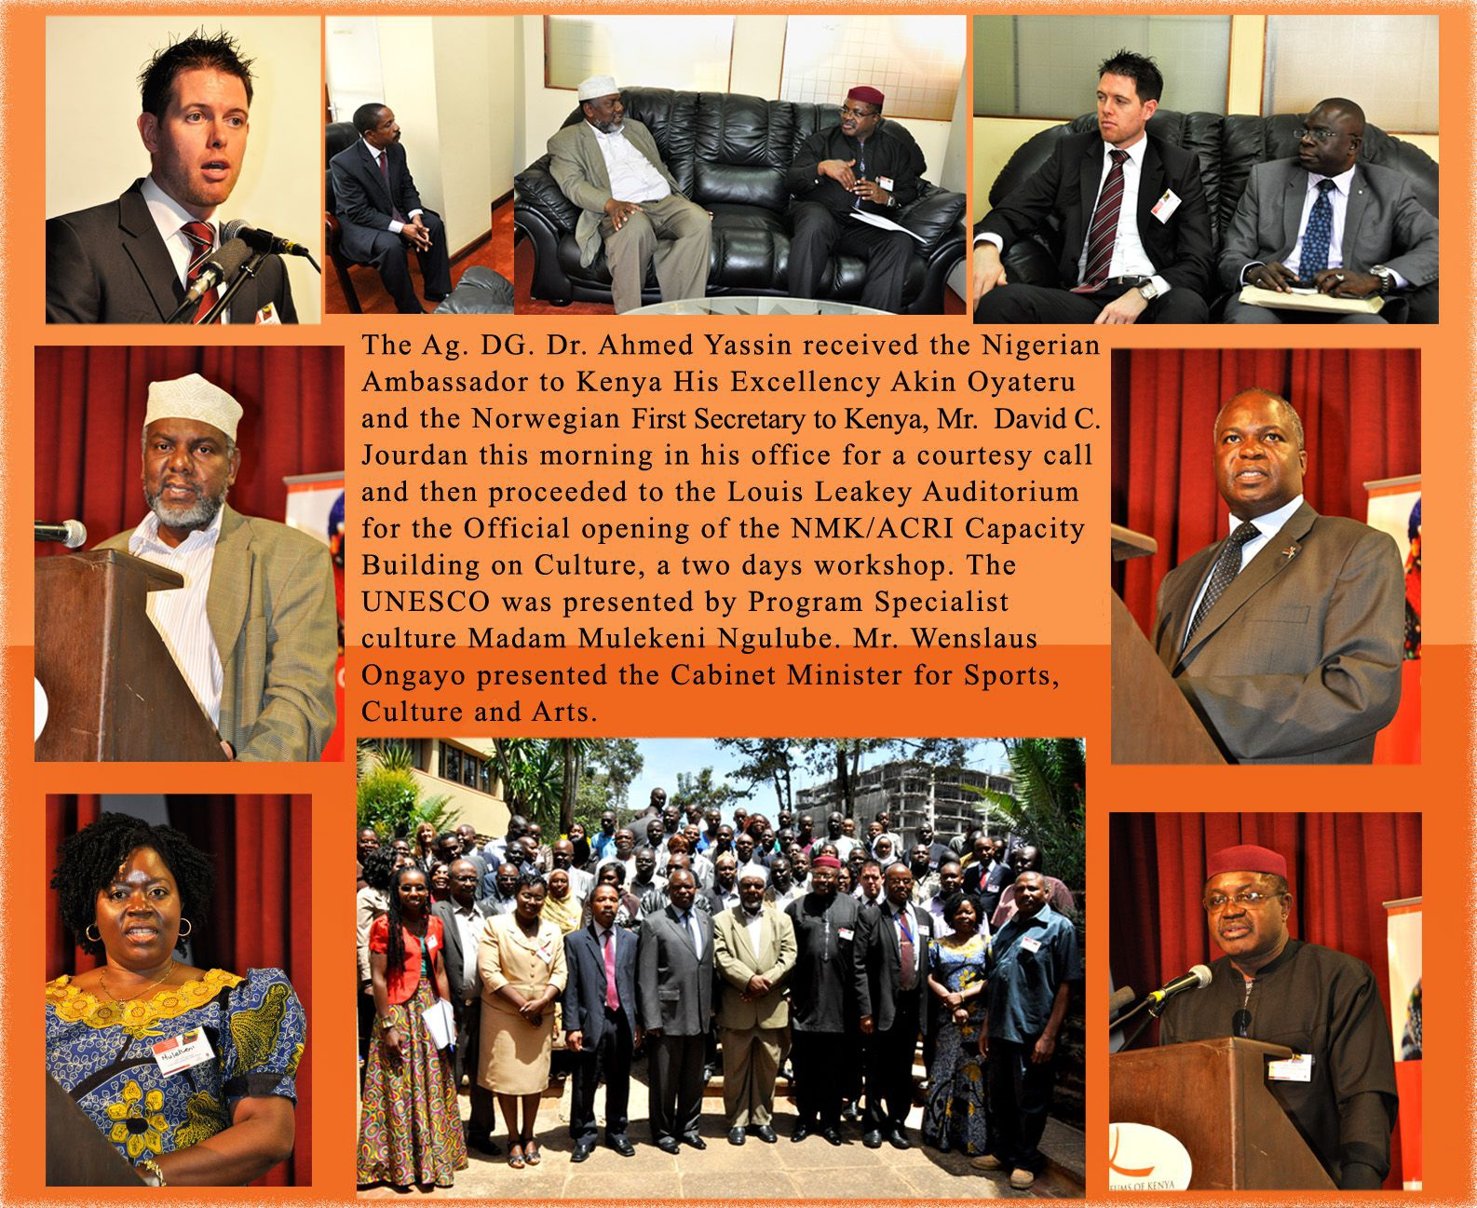
Workshop Highlights

Slide 9
IN GENERAL (for more information see www.utamaduni.or.ke )
As part of its mandate and in a bid to contribute and respond to public inquiries, the Cultural Heritage Department of the National Museums (NMK) partnered with the African Cultural Regeneration Institute (ACRI) to organize a workshop for Cultural Heritage stakeholders from the 47 Counties of Kenya.
The workshop was attended by 105 cultural stakeholders of whom 41 were county officials. It was also attended by the Nigerian High Commissioner to Kenya, Norwegian Embassy 1st Secretary, South Korean Embassy 1st Secretary and Mexican Embassy 1st Secretary.
Among other prominent guests was the Secretary General Kenya National Commission for UNESCO (KNATCOM), Dr Evangeline Njoka, UNESCO Programme Specialist for Culture, Nairobi Office, Ms. Ngulube Mulekeni, and a senior Member from Transitional Authority (Kenya Government), Mr. Bakari Omara. The workshop was officially opened by the Deputy Principal Secretary, Administration, the Ministry of Sports, Culture, and the Arts (MOSCA), on behalf of the Minister, Hon. Dr. Hassan Wario.
No external sponsor volunteered to participate in financing the workshop; the full burden was born by National Museums of Kenya, African Cultural Regeneration Institute, and Counties.

Slide 10
(2) INTRODUCTION OF COMMON UNIT ON CULTURE AT KCA UNIVERSITY
This is an initiative of the African Cultural Regeneration Institute (ACRI), started in 2014.
The rationale for the initiative is to integrate the positive awareness of the importance and imperatives of culture to the new generation of scholars who will, in the long run, spearhead the development of the country as leaders.
The course will promote self awareness and transmission of culture to the youth
The initiative enjoins the State Party, represented by the Cultural Heritage Department of National Museums of Kenya (NMK), and the Private Sector, represented by the KCA University as host.

Slide 11
CHALLENGING PROCESS
The initiative required the conviction of the University authorities about the importance of the program.
Then a course had to be designed broad enough to be acceptable for all academic orientations.
Based at the Faculty of Education and the Arts, it had to go through the Faculty Board for approval.
Thereafter, it will now be defended at the Deans’ Committee and, once approved, will be taken to the Senate for final approval.
The initiative requires extra financial backing outside the university resources, whether from the private sector or from the public sector, for successful implementation.

Slide 12
PURPOSE
The course is intended to make the students aware of the importance of culture in the development of the people of Kenya, and that cultural diversity is strength and not weakness.
UNESCO recommends culture as a powerful engine of sustainable development, mobilizing trend setting agreements that value culture and heritage, including tangible and intangible aspects.
On the one hand, when the young value and use their cultural foundations then future development of a country is assured.
On the other hand, when the young get alienated from their cultural heritage then endogenous development and effective socio-economic advancement is curtailed.

Slide 13
CONTENT OF THE COURSE
Definition of culture and analysis of positive and negative aspects;
Yardstick for evaluating positive aspects of culture based on international conventions on Human Rights;
Analysis of UNESCO Conventions on natural, cultural and human heritage;
The importance of culture in socio-economic development;
The value of cultural diversity in development;
History of cultural alienation in the underdevelopment of peoples;
Need for protecting intellectual properties and cultural resources;
The Five Pillars in the African Traditional Education;
Modernism, cultural alienation and underdevelopment;
The Hangzhou Declaration of May 2013 and the place of culture in the development agenda of the post 2015 era;
Varied professions that relate to culture and heritage;
Research into culture and creativity.

Slide 14
VISION
It is expected that, once the course takes root at KCA University, other universities will follow suit and borrow from the practice and begin teaching the Common Unit to their students.
This will mean that in future culture will be taken seriously by leaders and will be used as an engine of development.
Linked to this, ACRI, the KCA University, and the UNESCO Institute of Statistics (UIS), backed by the Kenya National Bureau of Statistics, Department of Culture, and the East African Community Secretariat, are planning a Workshop on Cultural Statistics, based on the 2009 UNESCO Framework of Cultural Statistics (FCS) to herald a course on Culture Statistics in the East African Community region.
Thus, knowing the impact Culture has on the economy will improve on budget allocations that are normally given to the Ministries of Culture.
END

