Slide 1
Reflecting on actual roles and future room for NGOs within UNESCO 2003 Convention for ICH in inter-national perspectives
ICH NGO FORUM, December 1, 2013,
Jorijn Neyrinck
ICH NGO Forum - http://www.ichngoforum.org/
tapis plein – Center of Expertise on ICH & particpation; Belgium

Slide 2
1. NGOs as framed by the 2003 Convention: the technical framework
1.1 WHAT DOES THE TEXT OF THE CONVENTION TELL US ABOUT NGOs?
II. Organs of the Convention = international
Article 9 – Accreditation of advisory organizations
1. The Committee shall propose to the General Assembly the accreditation of non-governmental organizations with recognized competence in the field of the intangible cultural heritage to act in an advisory capacity to the Committee.
2. The Committee shall also propose to the General Assembly the criteria for and modalities of such accreditation.
III. Safeguarding of the intangible cultural heritage at the national level = national
Article 11 – Role of States Parties
Each State Party shall:
(a) take the necessary measures to ensure the safeguarding of the intangible cultural heritage present in its territory;
(b) among the safeguarding measures referred to in Article 2, paragraph 3, identify and define the various elements of the intangible cultural heritage present in its territory, with the participation of communities, groups and relevant non-governmental organizations.

Slide 3
1. NGOs as framed by the 2003 Convention: the technical framework
1.2 WHAT DOES THE TEXT OF THE OPERATIONAL DIRECTIVES
of the 2003 CONVENTION TELL US ABOUT NGOs?
The Operational Directives emphasize the role of NGOs by specifying that NGOs shall participate at the national level “…in identifying and defining intangible cultural heritage and in other appropriate safeguarding measures…”. (Article 90)

Slide 4
1. NGOs as framed by the 2003 Convention: the technical framework
1.2 DETAIL: OPERATIONAL DIRECTIVES & NGOs
CHAPTER II The Intangible Cultural Heritage Fund
II.1 Guidelines for the use of the resources of the Fund (d) for the costs of advisory services to be provided, at the request of the Committee, by non-governmental and non-profit-making organizations, public or private bodies and private persons;
Chapter III Participation in the implementation of the Convention
III.2 Non-governmental organizations and the Convention
III.2.1 Participation of non-governmental organizations at the national level
90. In conformity with Article 11 (b) , States Parties shall involve the relevant non-governmental organizations in the implementation of the Convention of the Convention, inter alia in identifying and defining intangible cultural heritage and in other appropriate safeguarding measures, in cooperation and coordination with other actors involved in the implementation of the Convention.

Slide 5
1. NGOs as framed by the 2003 Convention: the technical framework
1.2 DETAIL: OPERATIONAL DIRECTIVES & NGOs (2)
III.2.2 Participation of accredited non-governmental organizations
Criteria for the accreditation of non-governmental organizations
= international
91. Non-governmental organizations shall:
have proven competence, expertise and experience in safeguarding (as defined in Article 2.3 of the Convention) intangible cultural heritage belonging, inter alia, to one or more specific domains;
have a local, national, regional or international nature, as appropriate;
have objectives that are in conformity with the spirit of the Convention and, preferably, statutes or bylaws that conform with those objectives;
cooperate in a spirit of mutual respect with communities, groups, and, where appropriate, individuals that create, practice and transmit intangible cultural heritage;
possess operational capacities, including:
a regular active membership, which forms a community linked by the desire to pursue the objectives for which it was established;
an established domicile and a recognized legal personality as compatible with domestic law;
having existed and having carried out appropriate activities for at least four years when being considered for accreditation.

Slide 6
1. NGOs as framed by the 2003 Convention: the technical framework
1.2 DETAIL: OPERATIONAL DIRECTIVES & NGOs (3)
Modalities and review of accreditation
92. The Committee asks the Secretariat to receive requests from non-governmental organizations and submit recommendations to it with regard to accrediting them and with regard to maintaining or terminating relations with them.
93. The Committee submits its recommendations to the General Assembly for decision, in conformity with Article 9 of the Convention. In receiving and examining such requests, the Committee shall pay due attention to the principle of equitable geographical representation based on information provided to it by the Secretariat. Accredited non-governmental organizations should abide by applicable domestic and international legal and ethical standards.
94. The Committee reviews the contribution and the commitment of the advisory organization, and its relations with it, every four years following accreditation, taking into account the perspective of the non-governmental organization concerned.
95. Termination of relations may be decided at the time of the review if the Committee deems it necessary. If circumstances require, relations may be suspended with the organization concerned until a decision regarding termination of these relations is taken.

Slide 7
1. NGOs as framed by the 2003 Convention: the technical framework
1.2 DETAIL: OPERATIONAL DIRECTIVES & NGOs (4)
Advisory functions
= international
96. Accredited non-governmental organizations who, according to Article 9.1 of the Convention, shall have advisory functions to the Committee, may be invited by the Committee to provide it,
inter alia, with reports of evaluation as a reference for the Committee to examine:
nomination files for the List of Intangible Cultural Heritage in Need of Urgent Safeguarding;
the programmes, projects and activities mentioned in Article 18 of the Convention;
requests for international assistance;
the effects of safeguarding plans for elements inscribed on the List of Intangible Cultural Heritage in Need of Urgent Safeguarding.

Slide 8
1. NGOs as framed by the 2003 Convention: the technical framework
1.2 DETAIL: OPERATIONAL DIRECTIVES & NGOs (5)
Procedure for accreditation
97. A non-governmental organization requesting accreditation to act in an advisory capacity to the Committee shall submit to the Secretariat the following information:
a description of the organization, including its full official name;
its main objectives;
its full address;
its date of founding or approximate duration of its existence;
the name of the country or countries in which it is active;
documentation showing that it possesses operational capacities, including proof of:
a regular active membership, which forms a community linked by the desire to pursue the objectives for which it was established;
an established domicile and a recognized legal personality as compatible with domestic law;
having existed and having carried out appropriate activities for at least four years when being considered for accreditation.
its activities in the field of safeguarding intangible cultural heritage;
a description of its experiences in cooperating with communities, groups and intangible cultural heritage practitioners.
98. Requests for accreditation shall be prepared by using the Form ICH-09 (available at www.unesco.org/culture/ich or on request from the Secretariat) and shall include all the information requested and only that information. Requests shall be received by the Secretariat at least four months before an ordinary session of the Committee.
99. The Secretariat shall register the proposals and keep up to date a list of non-governmental organizations accredited to the Committee.

Slide 9
1. NGOs as framed by the 2003 Convention: the technical framework
1.2 DETAIL: OPERATIONAL DIRECTIVES & NGOs (6)
Chapter IV Raising awareness about intangible cultural heritage and use of the emblem of the Convention for the Safeguarding of the Intangible Cultural Heritage
IV.1 Raising awareness about intangible cultural heritage
123. In order to assist the Committee in raising awareness of intangible cultural heritage, the UNESCO Secretariat shall:
….
(d) facilitate the exchange of information among communities and groups, civil society, non-governmental organizations, centres of expertise, research institutes and other entities with expertise or interest in the field of intangible cultural heritage;

Slide 10
2. NGOs statements and perspectives
4 NGO statements related to IGC (intergovernmental Committee) meetings:
Abu Dhabi - 4COM, 2009
Nairobi - 5COM, 2010
Bali - 6COM, 2011
Paris - 7COM, 2012
Recurring demand of attention for - community participation - the process of safeguarding and capacity building (and exchange of expertise) - acknowledgment of aspects of mediation, brokerage, facilitation by NGOs …

Slide 11
3. What about NGOs in the EVALUATION of UNESCO’s Standard-setting work of the Culture Section?
IOS (Internal Oversight Service) > evaluation of the implementation of the Convention and its impact
> a data-gathering exercise through a questionnaire that was sent to 150 of the 156 accredited NGOs (those for which an e-mail address was available) and was completed by 73 (49% response rate). Interviews were also conducted with almost 30 NGO representatives.
Pointing to the potential contributions of NGOs to implementation of the Convention at the national level, the IOS evaluation highlighted their important role as mediators and bridges between States and communities: ‘Many specialized NGOs not only have an excellent understanding of the Convention and relevant expertise, but are also connected to both local communities and Government. Their ability to link up the two should therefore not be underestimated’ (Document IOS/EVS/PI/129; the questionnaire is annexed to that report).

Slide 12
3. What about NGOs in the EVALUATION of UNESCO’s Standard-setting work of the Culture Section?
The IOS evaluation continues by citing a number of specific actions reported to it by NGOs or others, as follows (quoted in full):
explaining the Convention and its principles to communities;
conducting research projects on ICH;
conducting inventories of ICH in communities;
participating in the preparation of nomination files to the Convention’s Lists;
engaging in safeguarding activities such as research, the organisation of workshops, festivals, capacity building;
defending the specific interests of local communities in the face of Governmental authorities;
acting as the legal representatives of local communities in contracts with Governmental bodies, and
providing advice to Governments and Governmental bodies.

Slide 13
3. What about NGOs in the EVALUATION of UNESCO’s Standard-setting work of the Culture Section?
The IOS evaluation: Key evaluation findings on NGOs:
NGOs are acknowledged to play an important role in the implementation of the Convention at the national level. Their contribution is primarily focused on the implementation of safeguarding measures. Other important roles, such as contributing to cultural policy making or mediating and building bridges between various actors, such as between communities and Government, are less recognized.
At the international level, entry points for NGOs, including organizations representing ICH bearers, to contribute to decision making are limited. Many accredited NGOs feel that their accreditation status is not taken seriously by the IGC as the NGO forum Statement and individual contributions of NGOs and other observers are often not sufficiently considered during the debates and therefore do not have much effect on decisions taken by the IGC. The evaluation also notes that NGOs regularly attend the meetings of the Committee and General Assembly, calling particular attention to the NGO Forums that are organized prior to each Committee session and the consensus statements issued by NGOs at each session. The evaluation reports the will of NGOs to play a greater role in the implementation of the Convention, as well as their perception that their status as accredited NGOs is not taken seriously by the Committee and their contributions – whether expressed individually or collectively – are not sufficiently considered by the Committee or reflected in its decisions. It concludes that one reason for this lack of influence is the present criteria for accreditation, which in the view of many stakeholders are not stringent enough.

Slide 14
3. What about NGOs in the EVALUATION of UNESCO’s Standard-setting work of the Culture Section?
The IOS evaluation: Key evaluation findings on NGOs:
‘In order for NGOs to be perceived as serious partners in national and international safeguarding efforts as well as for the Convention’s mechanisms, their selection process and criteria need to be reviewed. Such a revision process should include a variety of stakeholders, including the NGOs themselves.’ Finally, with regard to the on-going monitoring and evaluation of the Convention’s implementation, particularly through the periodic reporting mechanism, the evaluation notes that ‘given that communities, NGOs, and many other stakeholders play a key role in the implementation of this Convention, no overall monitoring and follow up would be complete without also taking their views into account.’

Slide 15
3. What about NGOs in the EVALUATION of UNESCO’s Standard-setting work of the Culture Section?
The IOS evaluation > 4 of 24 Recommendations concern NGOs
These recommendations are presented in Document ITH/13/8.COM/5.c and reflected, in draft Decision 8.COM 5.c.1 as to be handled during the coming IGC Meeting in Baku, Azerbajan.
> The Periodic Reports from several countries demonstrate that policy making is fairly centralised and that while non‐state actors such as NGOs or research institutions are consulted to some extent, mechanisms to bring communities into the process often do not exist. NGOs have a key role to play in establishing the link between communities and the Government and in ensuring that policies and legislation are informed by the aspirations and the development needs of the communities concerned.
Recommendation 2.
Promote increased NGO and community involvement in the development of policy, legislation, safeguarding plans and sustainable development plans.

Slide 16
3. What about NGOs in the EVALUATION of UNESCO’s Standard-setting work of the Culture Section?
The IOS evaluation Recommendations concerning NGOs :
Recommendation 17
Encourage representatives of accredited NGOs to participate in IGC debates prior to voting on agenda items and include the outcomes of the NGO forums (such as the NGO Statements) in the Committee agendas.
Recommendation 18. Revise the accreditation process and criteria for NGOs to ensure that all accredited NGOs have the required experience and capacity to provide advisory services to the Committee.

Slide 17
3. What about NGOs in the EVALUATION of UNESCO’s Standard-setting work of the Culture Section?
The IOS evaluation Recommendations concerning NGOs :
Recommendation 23
Complement the data gathered on the implementation of the Convention through Periodic Reports submitted by State Parties with information provided by NGOs.
Periodic Reports are submitted by SPs and therefore primarily present the Government’s perspective, even though SPs are asked to involve communities, groups and concerned individuals in the reporting. This is not necessarily a shortcoming of the Periodic Reporting system, after all the Convention is an inter‐Governmental mechanism and it is ratified by Government and not by communities or groups. However, given that communities, NGOs, and many other stakeholders play a key role in the implementation of this Convention, no overall monitoring and follow up would be complete without also taking their views into
account. This could be done by allowing NGOs to provide feedback on SPs’ Periodic Reports during the meetings of the IGC and/or by inviting NGOs to submit comments on the Periodic Reports in writing, which the Secretariat could then make available to the IGC. > Other organizations also have practices that allow for NGO contribution to the reporting process. One is the Universal Periodic Review (UPR) process of the Human Rights Council (HRC), where two reports are submitted by each country under review in the UPR, one from Government and one from the NGO/CSO community, and then the HRC produces a summary report that relies on both.

Slide 18
4. Which is the state of the art on the side of NGOs? And what are the strengths, weaknesses and opportunities of NGOs in an inter-national perspective, concerning the work and implementation of the Convention?
Today, 156 NGOs are accredited in relation to the UNESCO 2003 Convention, an unhoped success, which runs parallel with the Convention’s ratification success.
The accreditation of NGOs is up to date an ‘accreditation to provide advisory services to the Intergovernmental Committee’. > Nevertheless, only a minority of NGOs delivers the stated advisory services because of the limited occasions in which the Convention appeals to the advisory services by NGOS.
Meanwhile, the NGOs are conscious of the benefits of their association with the Convention and engaged to introduce other aspects of refection by formulating a NGO Forum statement for 7.COM > http://ngoforum.pbworks.com/w/browse/ - view=ViewFolder&param=Paris December 2012 .

Slide 19
4. Which is the state of the art on the side of NGOs? And what are the strengths, weaknesses and opportunities of NGOs in an inter-national perspective, concerning the work and implementation of the Convention?
In this 7COM statement he NGO FORUM stressed - the important roles of NGOs for cultural mediation, raising awareness, representation and advocacy. - It confirmed the willingness of NGOs to contribute to the strengthening of the fundamental community participation in the implementation of the 2003 Convention,
- and to offer support and expertise in national and international processes for capacity building and safeguarding of ICH.
- Next to all this we should not forget to mention also the important effect that the status of UNESCO accreditation is empowering NGOs in their independent role acting in between heritage communities on the one hand and on the other hand states parties in which territory they are active.

Slide 20
4. Which is the state of the art on the side of NGOs? And what are the strengths, weaknesses and opportunities of NGOs in an inter-national perspective, concerning the work and implementation of the Convention?
Undoubtedly a great variety of NGOs is affiliated with the Convention:
- As for their positioning between governments and bearers (practitioners) of ICH, one can notice the whole spectrum from organizations tightly connected (if not equal) to bearers of ICH, through (prevailing, as it seems) cultural brokerage or mediating organizations, to organizations that function as a non-governmental counterpart of governmental bodies.
> Also, there are huge differences in terms of how mediation is conceived and put into practice.
- There are large differences between accredited NGOs as well in terms of what kind of expertise predominates – e.g. knowledge on ICH element(s) in question, management skills, proficiency in ICH program, expertise in the functioning of cultural flows beyond ICH program per se, scholarly knowledge in particular domains of ICH, etc.
- The scope of aims and activities also differs to a large degree – from organizations dedicated to a very specific segment of ICH to organizations covering all domains of ICH as defined in the Convention.
- Similarly, their cultural-territorial scope varies from very local to worldwide organizations.

Slide 21
4. Which is the state of the art on the side of NGOs? Quick overview by the Report prepared by the Secretariat (on website 8COM since Monday Nov 4th > ITH/13/8.COM/14.b)
Profile of the NGOs accredited and the nature of their work
Evolution of NGO accreditation: To date, the General Assembly has accredited 156 organizations upon recommendation of the Committee (97 in 2010, by its Resolution 3.GA 7, and 59 in 2012, by its Resolution 4.GA 6). At its seventh session the Committee recommended an additional 10 NGOs for accreditation (Decision 7.COM 16.a) and at its eighth session the Committee may wish to recommend 12 more (Document ITH/13/8.COM/14.a). The data reflect only those NGOs already accredited by the General Assembly.
Geographic distribution: Geographic distribution is based on the address of the organization’s headquarters. Of the 156 accredited NGOs, 79 are based in Electoral Group I, 9 in Electoral Group II, 13 in Electoral Group III, 34 in Electoral Group IV, 18 in Electoral Group V(a) and 3 in Electoral Group V(b).

Slide 22
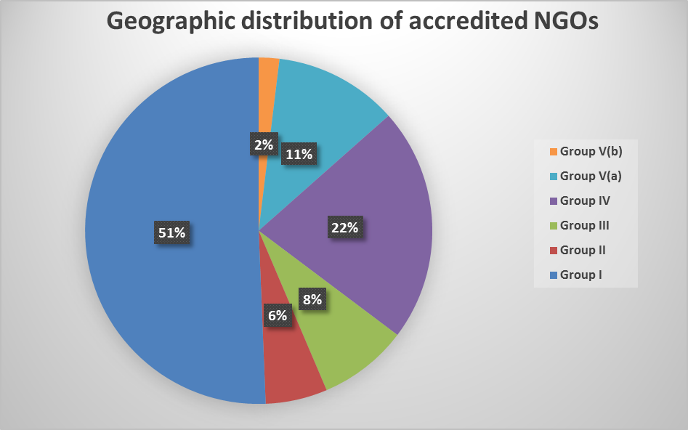
4. Which is the state of the art on the side of NGOs? Report ITH/13/8.COM/14.b
Profile of the NGOs accredited and the nature of their work (2)

Slide 23
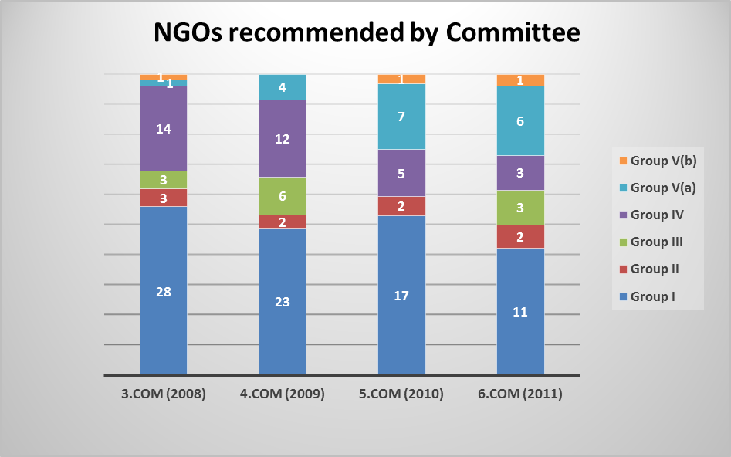
4. Which is the state of the art on the side of NGOs? Report ITH/13/8.COM/14.b
Profile of the NGOs accredited and the nature of their work (3)
The initial cycle of NGOs recommended by the Committee showed a disproportionate concentration of requests from Electoral Groups I and IV. Through targeted interventions of the Secretariat, the proportion of NGOs from Africa increased substantially in subsequent years. However, the numbers of accredited NGOs from Electoral Groups II and V(b) remains low.

Slide 24
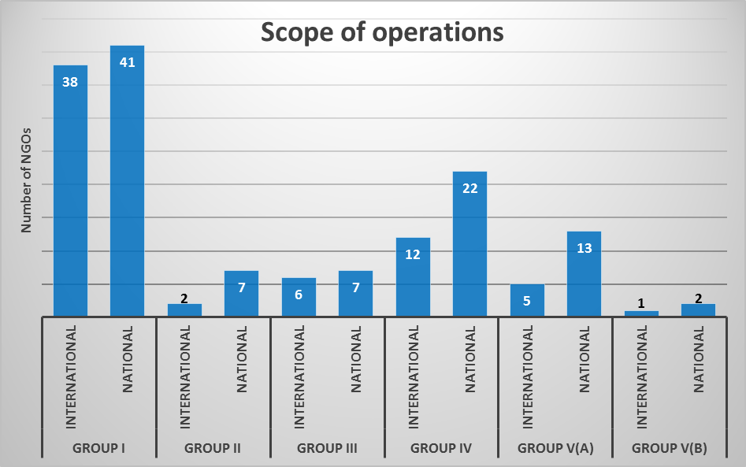
4. Which is the state of the art on the side of NGOs? Report ITH/13/8.COM/14.b
Profile of the NGOs accredited and the nature of their work (4)
Country or countries in which the organizations are active: 92 NGOs (59%) of the accredited organizations indicated that they operate at the national level and 64 NGOs (41%) stated that their activities are international in scope. NGOs in Electoral Groups I and III are more likely to report international activities than those in the other four groups.

Slide 25
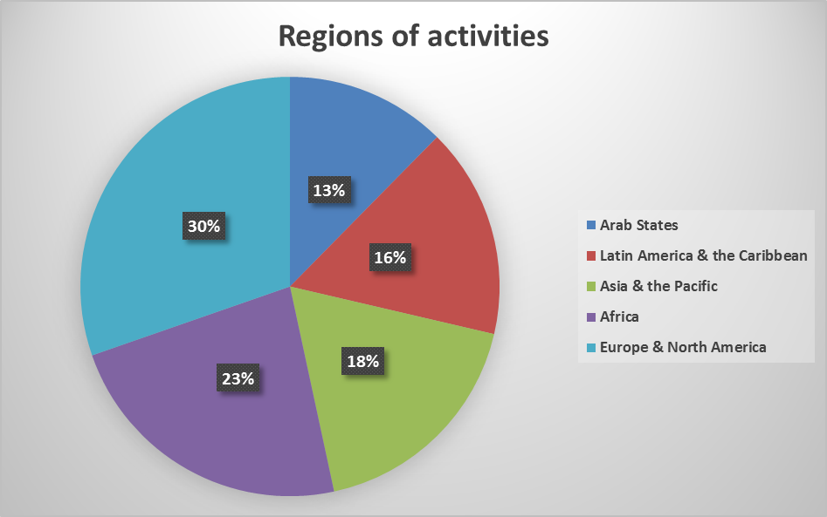
4. Which is the state of the art on the side of NGOs? Report ITH/13/8.COM/14.b
Profile of the NGOs accredited and the nature of their work (5)
Regardless of the location of their headquarters or whether they are national or international, accredited NGOs report carrying out activities throughout the world. (These data are tracked by geographic region rather than electoral group.)

Slide 26
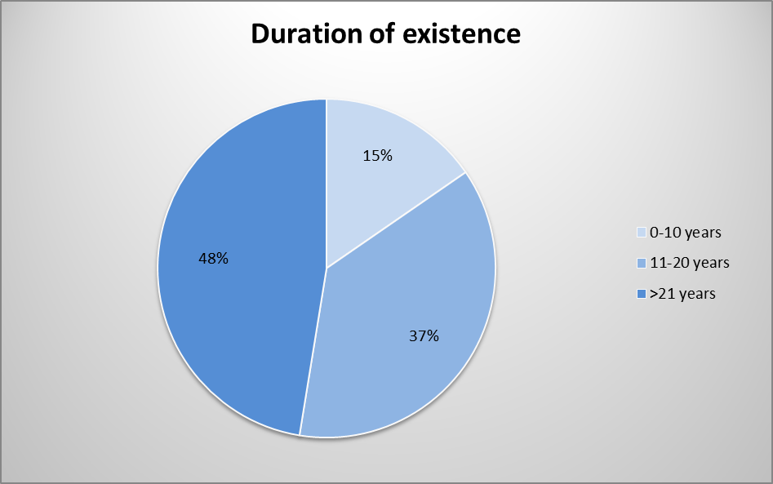
4. Which is the state of the art on the side of NGOs? Report ITH/13/8.COM/14.b
Profile of the NGOs accredited and the nature of their work (6)
Duration of existence is based on the date of the founding of the organization as indicated in its request for accreditation. To date, 74 accredited NGOs have stated that they have worked for more than 20 years, 58 have existed for more than 10 and fewer than 20 years and 24 indicate that they have existed for 10 years or fewer.

Slide 27
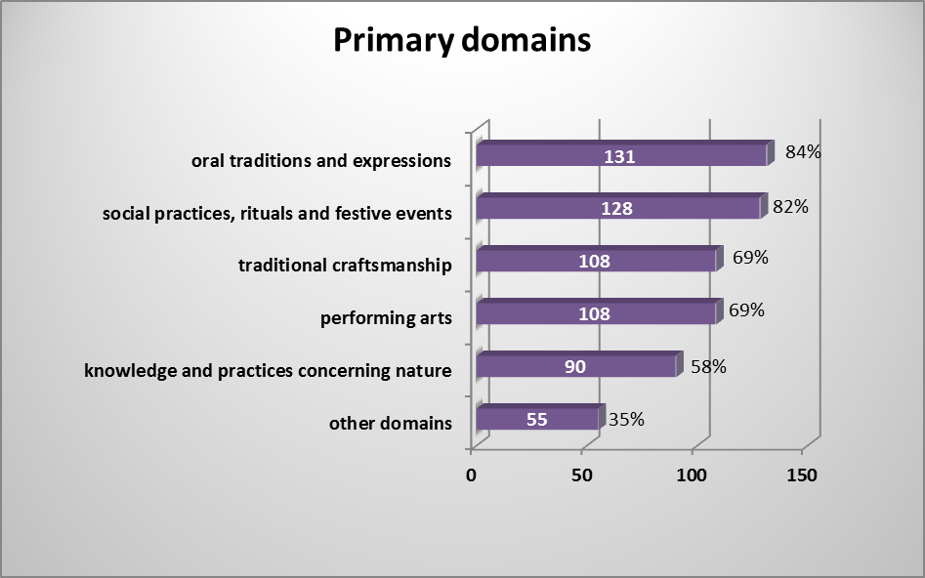
4. Which is the state of the art on the side of NGOs? Report ITH/13/8.COM/14.b
Profile of the NGOs accredited and the nature of their work (7)
Domains in which the organization is active: In their requests for accreditation, NGOs are requested to tick one or several boxes in order to indicate the primary domains in which they are most active. > The vast majority indicated several domains (e.g. 84% reported working on oral traditions and expression; 82% on social practices, rituals and festive events; etc.), with more than half ticking all five domains indicated. Fifty-five organizations indicated working on ‘other’ domains, which included poverty reduction among indigenous peoples, strengthening conflict resolution systems or intangible heritage and sustainable development. Only ten NGOs reported working in a single domain.

Slide 28
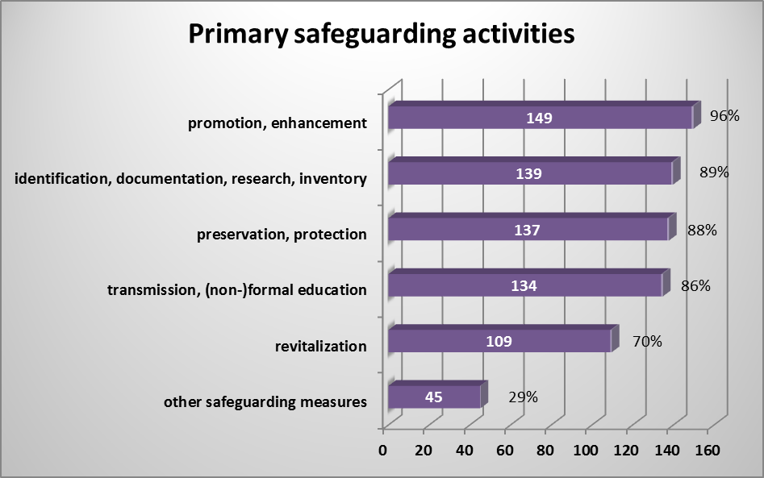
4. Which is the state of the art on the side of NGOs? Report ITH/13/8.COM/14.b
Profile of the NGOs accredited and the nature of their work (8)
Primary safeguarding activities in which the organization is involved: NGOs requesting accreditation are asked to tick one or more boxes to indicate the organization’s primary safeguarding activities. Here again, most accredited NGOs ticked all five boxes, indicating that their primary activities span the safeguarding measures listed. Other safeguarding measures, indicated by 45 NGOs, included activities such as digitization of audio-visual archives, promotion of culture for employment and growth, using culture for innovating goods and services, training of trainers, etc.

Slide 29
4. Which is the state of the art on the side of NGOs? Report ITH/13/8.COM/14.b
Profile of the NGOs accredited and the nature of their work (9)
Participation at the national level, as reported by States Parties:
In addition to the data available in the accreditation requests, the Secretariat attempted to trace the work of NGOs through the periodic reports submitted by States Parties.
Of the 47 reports analysed (not all of which have been finalized for examination by the Committee),
34 reports mentioned participation of non-governmental organizations in the implementation of the Convention at the national level.
Fourteen reports referred specifically to the contribution of accredited NGOs, but several only listed the name of the organization without describing its contribution.
Almost a quarter of the State Parties in which accredited NGOs are based made no mention of them when submitting periodic reports.
The nature of their contribution includes cooperation with the ministries in charge of implementation of the Convention (e.g. Belgium); establishment of working groups and networking (e.g. France, Republic of Korea); inventorying (e.g. Burkina Faso, Cyprus, Mexico); research (e.g. Kyrgyzstan, Viet Nam) as well as promotion, transmission and revitalization.

Slide 30
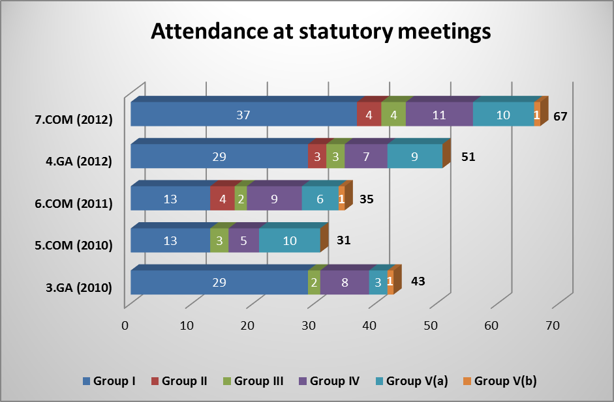
4. Which is the state of the art on the side of NGOs? Report ITH/13/8.COM/14.b
Profile of the NGOs accredited and the nature of their work (10)
Attendance at meetings of the Committee and Assembly:
Attendance of accredited NGOs in the Committee and General Assembly meetings is recorded in the lists of participants. Shown below is attendance beginning from the third session of the Assembly, which accredited the first 97 NGOs. The participation of ten African NGOs in the fifth session of the Committee was supported by the Republic of Hungary and that of 14 NGOs from developing countries in the seventh session of the Committee was financed by the Intangible Cultural Heritage Fund. Altogether, a total of 97 accredited NGOs attended one or more meetings; of these, 27 attended a single meeting and 32 attended twice.
There is thus a core
of some 30-40 NGOs
that participate regularly
in the governance meetings
of the Convention.

Slide 31
4. Which is the state of the art on the side of NGOs? Report ITH/13/8.COM/14.b
Profile of the NGOs accredited and the nature of their work (11)
Participation of NGO representatives in the work of the Consultative Body:
According to paragraph 26 of the Operational Directives, accredited NGOs participate in the Consultative Body charged with evaluating nominations to the Urgent Safeguarding List, proposals for the Register of Best Safeguarding Practices and requests for International Assistance greater than US$25,000 and with providing recommendations to the Committee concerning such files.
Following the principle of equitable geographic distribution
and the duration of the mandate of members of the Consultative Body,
only 6% of all accredited NGOs (10 NGOs in total) have served on the Consultative Body to date.

Slide 32
5. Which potential developments can we imagine and foresee concerning NGOs in relation to the 2003 Convention?
(Some) implications of the diversity of NGOs are well-known for the NGOs themselves.
Of course we should first stress the enriching meetings and extremely valuable exchange of experiences of NGO colleagues sharing the objectives of safeguarding ICH throughout the world.
But working with the NGOs takes and needs a lot of TRANSLATION/FACILiTATION/MEDIATON tools in itself,
on a series of aspects: -cultural diversity - scale diversity - scope diversity - language for learning form one another’s methodology (good practices, community participation, capacity building, education, etc) - frequency of participating
The effect is well known: every NGO Forum meeting brings partly well-known colleagues, partly new faces. Almost no NGO has the funds for participating to all IGC or GA meetings, and every new meeting brings new accredited NGOS. Given this dynamic context, makes development of the cooperative NGO work a challenge. The meetings happen to be combining the necessary ‘first introductions of new people and organizations’ while proceeding the work of strengthening the international forum of NGOS cooperating within the UNESCO 2003 framework.

Slide 33
5. Which potential developments can we imagine and foresee concerning NGOs in relation to the 2003 Convention?
The unforeseen enthusiasm and large extent of NGOs registering for accreditation brings nevertheless accordingly administrative and procedural paperwork for the ICH Secretariat, in a period where means and sources are becoming more scarce.
In this context the question was raised on 7.COM to possibly review the criteria for accreditation and evaluation of the NGOs.
In Decision 7.COM 16.be the Intergovernmental Committee expresses its regrets for the limited opportunities until now to act in advisory capacity to the committee and requested the Secretariat to report at 8.COM on the profile of the NGOS accredited and the nature of their work, and to propose an evaluation form for assessing their potential contribution to the implementation of the Convention.
This makes that, during the Intergovernmental Committee Meeting 8.COM in Baku Azerbaijan (December 2013), one of the (many) items at stake will be the reflection on the criteria and modalities for accreditation of non-governmental organizations.

Slide 34
5. Which potential developments can we imagine and foresee concerning NGOs in relation to the 2003 Convention?
What do we learn further from the report by the Secretariat in ITH/13/8.COM/14.b concerning the coming BCOM IGC meeting ?
> Implications and limitations of the present profile of NGOs
With regard to the nature of the work of NGOs, the Committee has previously taken note of the ‘important contributions that numerous non-governmental organizations make world-wide to the implementation of the Convention at the local, national and international levels’ (Decision 7.COM 16.b). The limited information available to the Secretariat, however, does not provide sufficient evidence to assess such contributions quantitatively or qualitatively.
The profile also does not help to demonstrate what the NGOs’ potential contributions to implementation could be. With regard to their potential contributions to implementation at the local and national levels, for example, the size of the organization, the nature of its membership and the scale of its annual budget would seem to be relevant considerations, but the quality and sufficiency of information reported in the accreditation requests and in the periodic reports did not allow analysis. With regard to their potential contribution to the work of the Committee through providing advisory services, the data were similarly lacking. Therefore the Secretariat proposes the following:

Slide 35
5. Which potential developments can we imagine and foresee concerning NGOs in relation to the 2003 Convention?
What do we learn further from the report by the Secretariat in ITH/13/8.COM/14.b concerning the coming BCOM IGC meeting ?
Therefore the Secretariat proposes the following:
In its Decision 7.COM 16.b, the Committee requested that the Secretariat propose an evaluation form for assessing the potential contribution of accredited NGOs to the implementation of the Convention. As requested, the Secretariat drew up a draft form that is annexed to the present document. The form aims at collecting information both on the contribution of the NGO to the safeguarding of intangible cultural heritage and implementation of the Convention at the national level (Chapter III of the Convention) and to its implementation at the international level, particularly as regards the NGO’s participation in the work of the Committee and its capacities to act in an advisory capacity. When drafting the form, the Secretariat benefitted from the feedback and suggestions of members of the NGO Forum.
Given that the Committee was asked by the General Assembly to reflect on the criteria and procedures for accreditation (Resolution 4.GA 6), it may wish to propose that the criteria be revised to ensure that all accredited NGOs have the required experience and capacity to act in an advisory capacity to the Committee. In that case, revision of the present form for requesting accreditation and finalization of the draft report form could take place only after the fifth session of the General Assembly in June 2014.
That would imply that the 97 NGOs accredited in 2010 would be asked to submit their reports at the end of 2014, for examination by the Committee at its tenth session in 2015. As noted in Document ITH/13/8.COM/10, this schedule would also avoid an overcharged agenda for the ninth session

Slide 36
5. Which potential developments can we imagine and foresee concerning NGOs in relation to the 2003 Convention?
What do we learn further from the report by the Secretariat in ITH/13/8.COM/14.b concerning the coming BCOM IGC meeting ?
DRAFT DECISION 8.COM 14.b
Recommends to the General Assembly to revise the Operational Directives for the implementation of the Convention in order to revise the accreditation process and criteria for NGOs to ensure that all accredited NGOs have the required experience and capacity to act in an advisory capacity to the Committee; and requests the Secretariat to propose draft Operational Directives reflecting its debates during the present session, for examination by the General Assembly at its fifth session;
Decides to complement the data gathered on the implementation of the Convention through Periodic Reports submitted by States Parties with information provided by NGOs; and requests the Secretariat to propose draft Operational Directives to that effect, reflecting its debates during the present session, for examination by the Committee at its ninth session (>Dec. 2015).

Slide 37
5. Which potential developments can we imagine and foresee concerning NGOs in relation to the 2003 Convention?
This NGO FORUM SYMPOSIUM on Dec 1 in Baku is aiming to contribute in the context of 8.COM by bringing the diverse experience and ideas of associated NGOs in the reflections and debates:
Dealing with questions as ‘Which contribution brings this rich and colourful palette of NGOs to the implementation of the Convention?’ And ‘how could or should NGO accreditation and management be organized to produce at best the desirable effects for the Convention’s mission of the safeguarding of ICH?’

