Slide 1
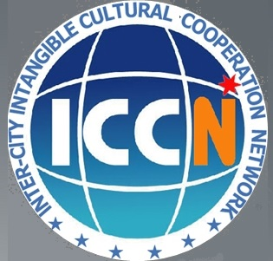
NGOs, the mediator of communication and information flow between communities and the states; the case of ICCN
Sumi Nam, ICCN Secretariat

Slide 2
CONTENTS
1 What is ICCN?
2 NGOs, the great mediator
: a case of ICCN Conference
3 NGOs, the great mediator
: a case of ICCN Festival
4 Conclusion

Slide 3
What is ICCN?

Slide 4
What is ICCN?
01
ICCN = Inter-City IntangibleCultural
Cooperation Network
The only international organization of local government level for Sustainable Local Development
and Realization of Cultural Peace through the safeguarding and promotion of Intangible Cultural Heritage.

Slide 5
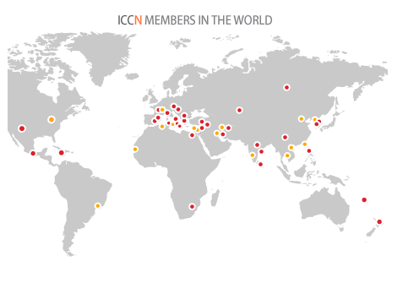
What is ICCN?
01
40 cities from 35 countries and 25 organizations
(2013.11)

Slide 6
What is ICCN?
01
2014 ICCN Conference and 2nd ICCN Festival, Isfahan, Iran
2013 6th Thematic Workshop, Dubrovnik, Croatia
ICCN festival as 10th Anniversary of UNESCO Convention
2012 "2012 ICCN World Intangible Culture Festival", GANGNEUNG, Korea
Final Accreditation as the advisory NGOs to the Committee of UNESCO
2011 5th Thematic Workshop/ 2nd ICCN Youth Forum, GANNAT, France
2010 3rd International Round Table of Mayors/
1st ICCN Youth Forum, VLCNOV, Czech Republic
2008 2nd International Round Table of Mayors CAIRO, Egypt
: Official Founding of the ICCN
2004 1st International Round Table of Mayors , GANGNEUNG, Korea

Slide 7
What is ICCN?
01
MAJOR ACTIVITIES OF ICCN
1. General Assembly
2. Thematic Workshop
3. Youth Forum
4. ICCN Festival

Slide 8
NGOs,
the great mediator
: the case of ICCN Conference

Slide 9
NGOs, the great mediator
: the case of ICCN Conference
02
......the Internal Oversight Service evaluation highlighted their important role as mediators and bridges between States and communities:"Many specialized NGOs not only have an excellent understanding of the Convention and relevant expertise, but are also connected to both local communities and governments......
(Document IOS/EVS/PI/129; quoted in ITH/13/8.COM/14.b)

Slide 10
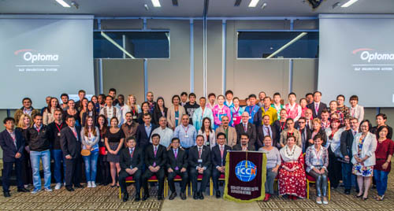
NGOs, the great mediator
: the case of ICCN Conference
02
6th ICCN Thematic Workshop in Dubrovnik
"Youth in Safeguarding ICH", Oct. 2 to 6, 2013
A. International Participants
: 26 cities of 23 states, 8 Cultural institutions
B. Local Participants
: about 100 participants including 25 presenters

Slide 11
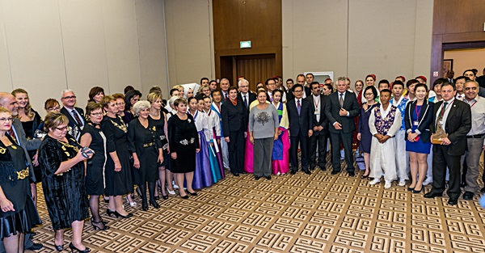
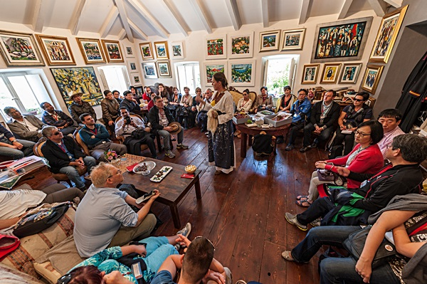
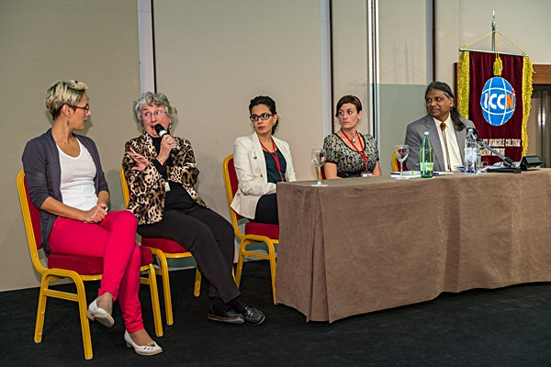
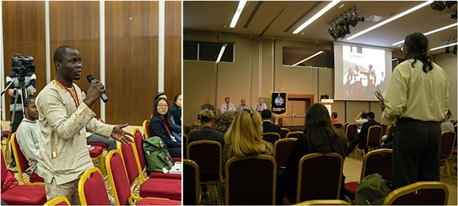
NGOs, the great mediator
: the case of ICCN Conference
02
Sketches of 2013 workshop

Slide 12
NGOs the great mediator
: the case of ICCN Conference
02
NGOs as the mediator of information and communication flow
the Convention
Accredited NGOs
내용
내용
open communication
capacity Building
Local NGOs
Communities

Slide 13
NGOs,
the great mediator
: the case of ICCN Festival

Slide 14
NGOs, the great mediator
: the case of ICCN Festival
03
ICCN Festival
: a model that realizes the goals of the convention of awareness rising on importance of intangible culture, proving its value as a source of sustainable development, need of community involvement, power of international cooperation, and realization of cultural peace

Slide 15
NGOs, the great mediator
: the case of ICCN Festival
03
Two inevitable challenges
1. Obstacles in Language and logistics of ICH bearers
2. Demonstrating ICH in balanced of distortion and demonstration of core value

Slide 16
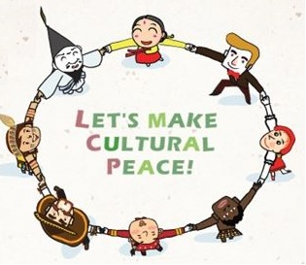
NGOs, the great mediator
: the case of ICCN Festival
03
2012 ICCN Festival in Gangneung
"The Value of Intangible Culture, Find it in a City!"
Oct. 19. - 28, 10 days

Slide 17
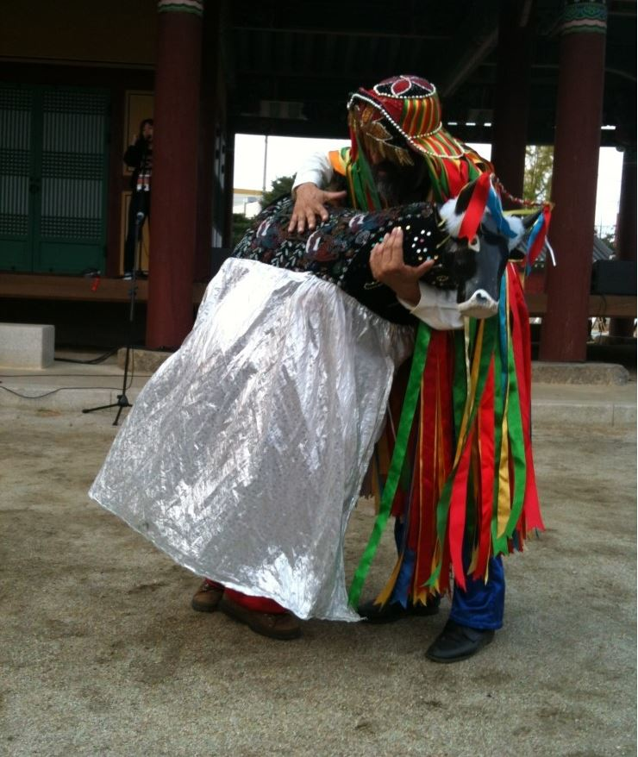
NGOs, the great mediator
: the case of ICCN Festival
03
The case of ArteSol, Brazil
"브라질 아테솔 공연이었는데요.통역하시는 분께서 배경 설명도 해주시고공연 중간중간의 대사도 통역해주셔서 즐겁게 보았답니다.또한 마지막 관람객들과 신명나게 같이 어울리기도 했었구요."
" There was a performance from Artesol, Brazil. (While they are performing), it made more fun that a mediator gave its cultural background and even translation of what they said. Also, it was so much fun to hang out with all of people there!"
-quoted from a blogger (http://blog.naver.com/yomanghouse?Redirect=Log&logNo=90155535378)

Slide 18
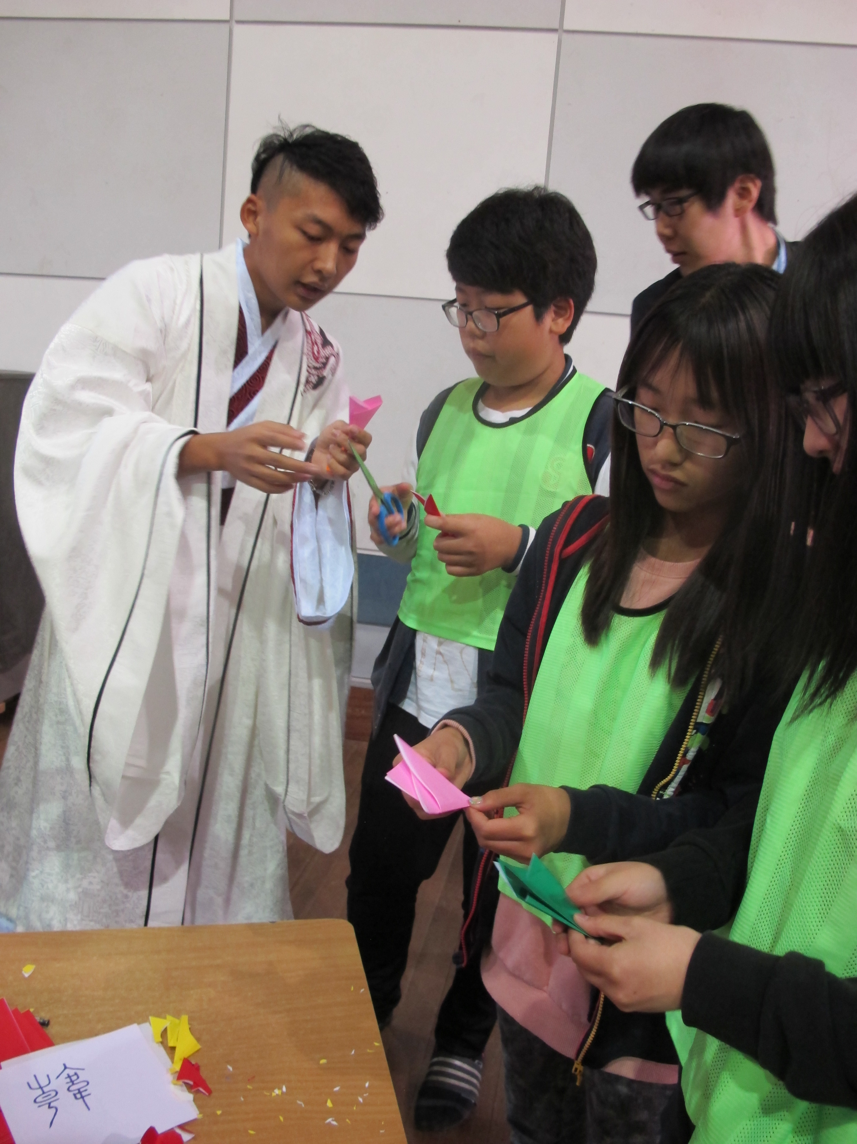
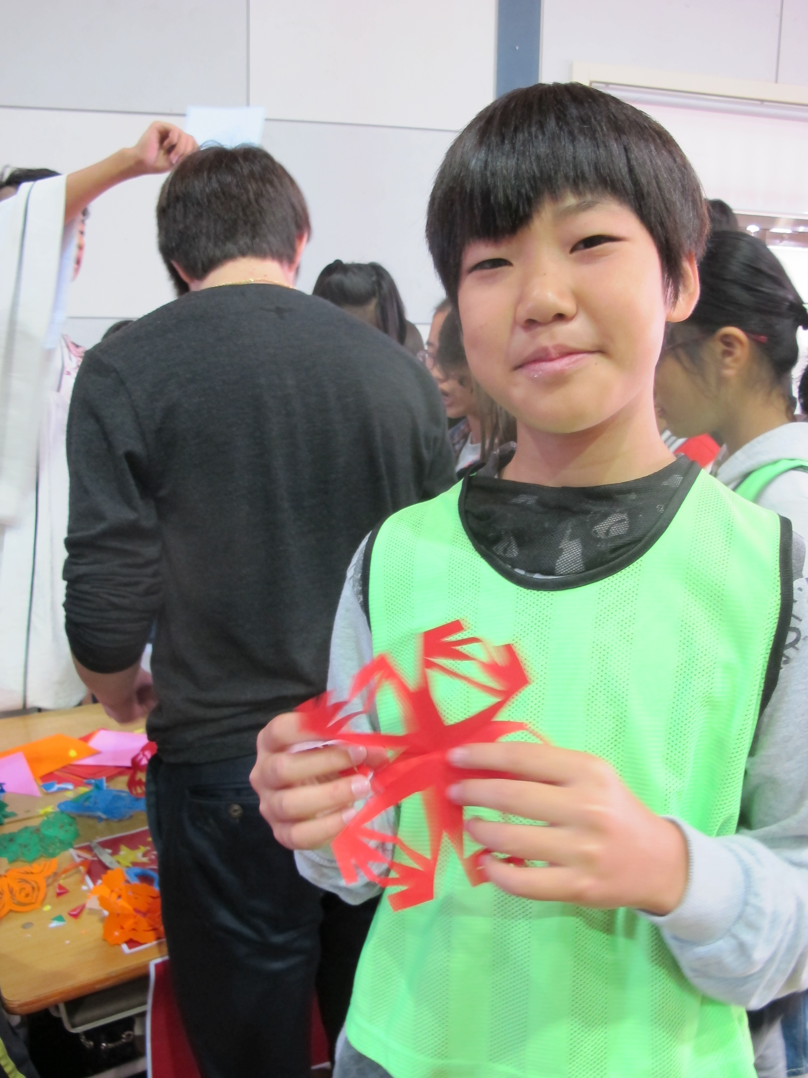
NGOs, the great mediator
: the case of ICCN Festival
03
The case of Yiswind, China

Slide 19
NGOs, the great mediator
: the case of ICCN Festival
03
NGOs, the window and voice of local communities and the great advisors
Language
Core Value of ICH
NGOs
Public
Balanced way
Local Surroundings

Slide 20
Conclusion
: 2nd ICCN Festival in Isfahan

Slide 21
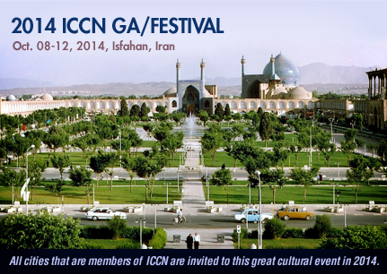
Conclusion
: 2nd ICCN Festival in Isfahan
2014 ICCN International Festival and GA
Oct. 8 to 12, 2014, Isfahan, Iran
www.iccn2014.com

Slide 22
Thank you

