Slide 1
CSOs and experts: between ‘cultural communities’ and the State
Antonio Arantes
ArteSol - Solidary Crafts
UNICAMP – State University of Campinas
Brazil

Slide 2
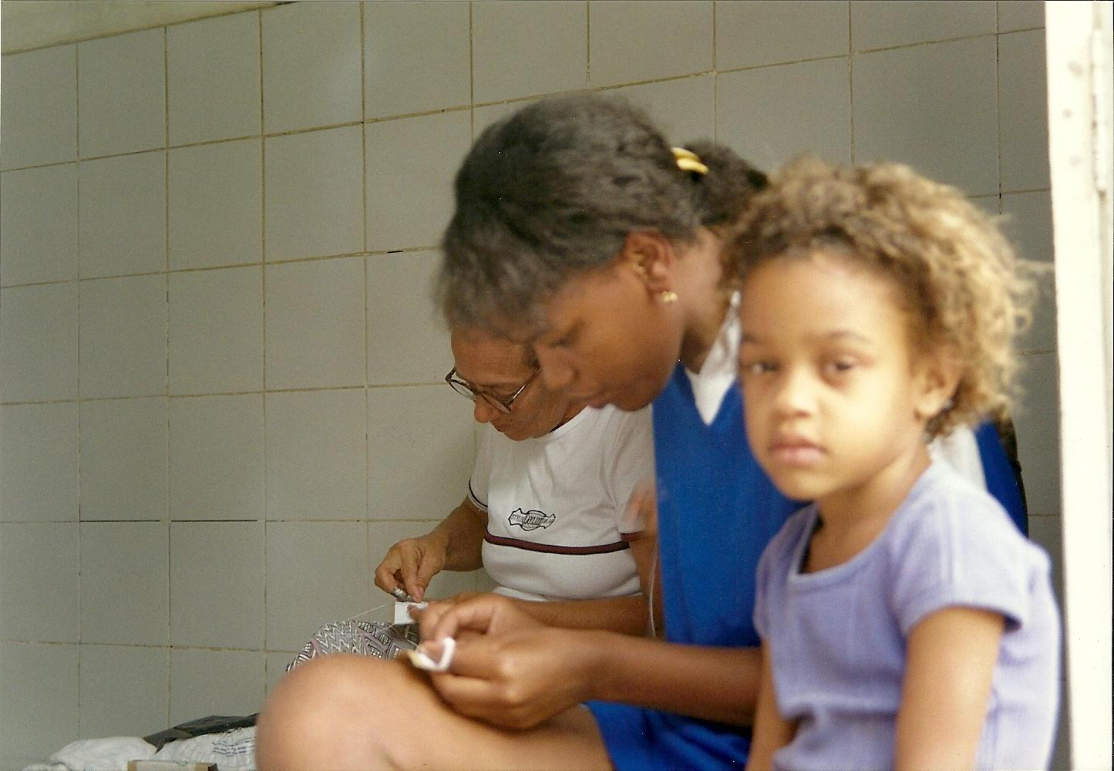
.
ARTESOL - Mission
Safeguard traditional craftwork as cultural heritage , promoting the autonomy of artisans in the execution and transmission of their trade, as well as the improvement of their living conditions.

Slide 3
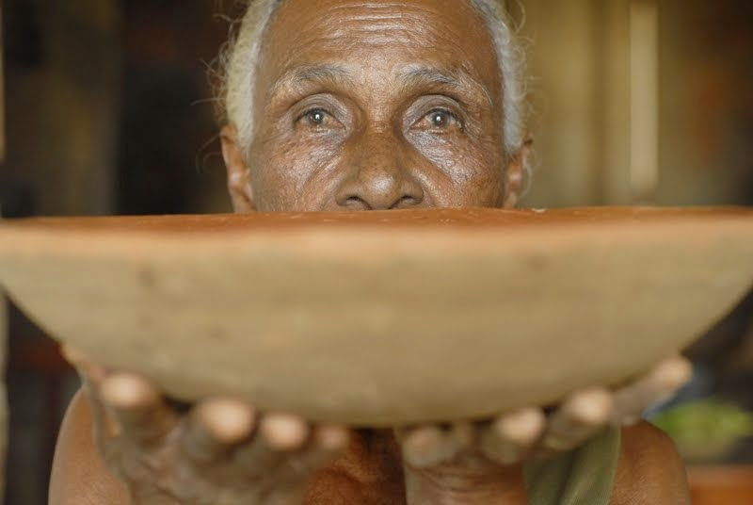

Slide 4
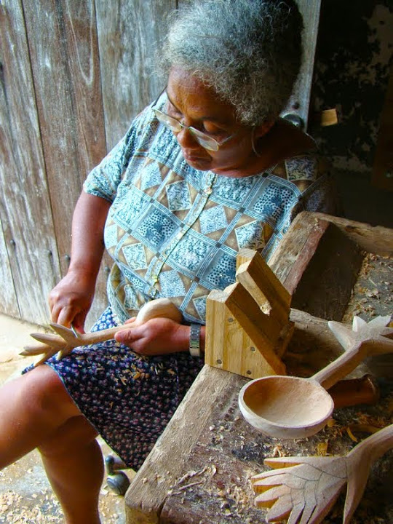

Slide 5
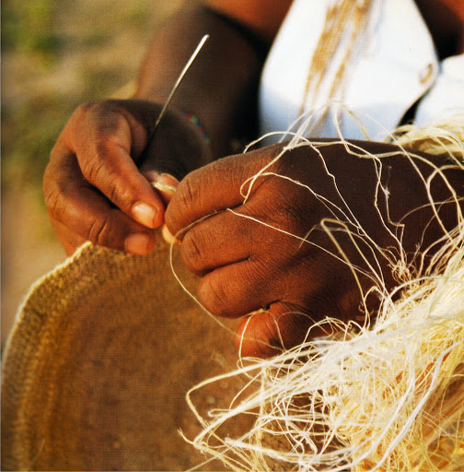

Slide 7
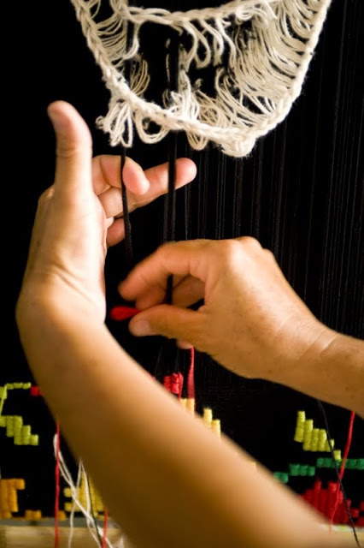

Slide 8
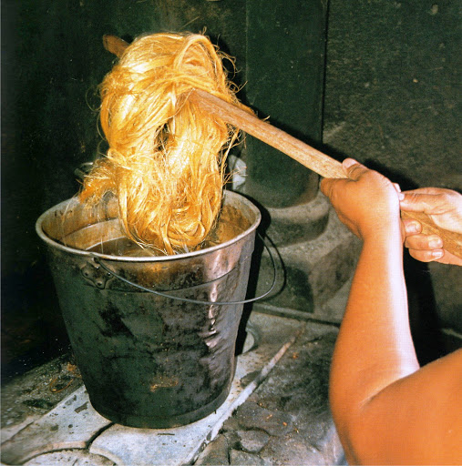

Slide 9
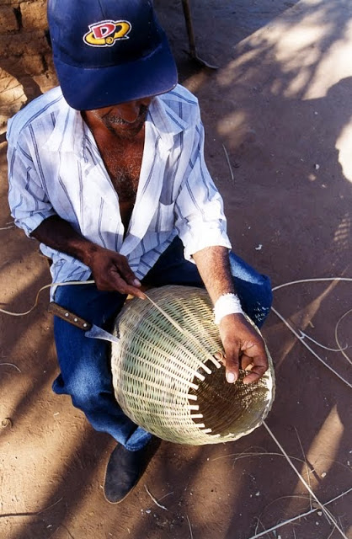

Slide 10
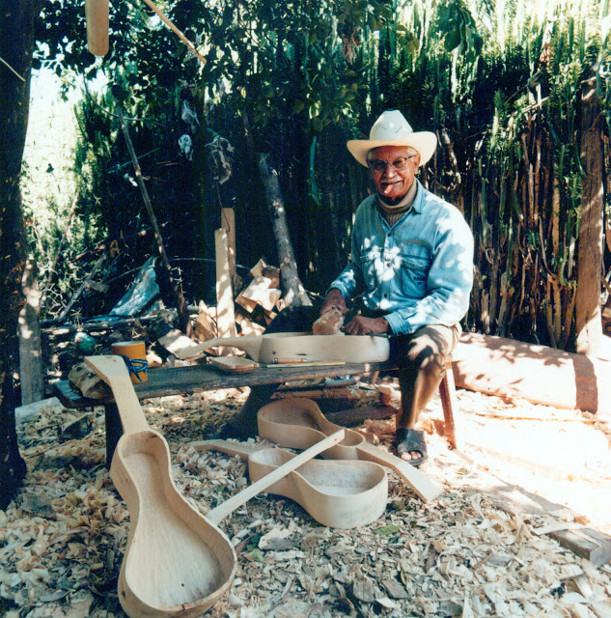

Slide 11
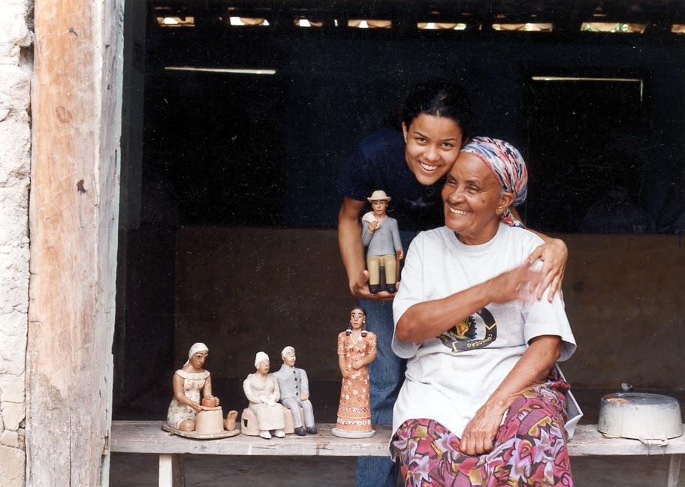

Slide 12
“The past is alive; this knowledge is alive; this form of art is in existence.
We should not see popular arts as “alternative” ways of making a living. They are legitimate and valuable in themselves.
We want to look towards the future. And to look further into the future means to integrate tradition and modernity”.
Ruth Cardoso, anthropologist
Founder of ArteSol

Slide 13
http://www.artesol.org.br/site/english
antonioarantes@terra.com.br
Notes:
13

