Slide 1
Exploring Cultural Diversity Dutch ICH Policies and the Contribution of NGOs
Riet de Leeuw (Ministry of Culture) and Albert van der Zeijden (scientific policy official Dutch Centre for Intangible Heritage)
ICH NGO Forum, Paris 23 November 2014

Slide 2
Riet de Leeuw
Senior policy officer
Ministry for Education, Culture and Science
Department for Heritage and Arts
The Netherlands

Slide 3
Starting points cultural policy ICH
The Netherlands ratified in 2012
Ministry of Education, Culture and Science responsible for the implementation of the Convention
Working together with: Ministry of Foreign Affairs, Ministry of Social Affairs, Ministry of Infrastructure and the Environment
Working together with the government of the 12 provinces and municipalities
No addition or amendment needed to existing legislation

Slide 4
Starting points cultural policy ICH
National Inventory
Research
Safeguarding methods
Capacity building (Caribbean parts Kingdom and Suriname)
Monitoring/Evaluation: Heritage Monitor

Slide 5
Criteria National Inventory
Bottom-up
At the heart of the inventory: communities, groups and individuals
Inventory: of, for and by the bearers of ICH
Accessible and interactive: website
Cultural divers

Slide 6
Implementation
Center for Intangible Cultural Heritage (VIE): independent cultural organization, funded by the Ministry
Coordination implementation of the Convention/National Inventory
Network function: working together with museums, universities, training institutes etc.
Cultural Participation Fund: programme to encourage the spirit of participation and engagement in arts and heritage
Funding scheme for intangible heritage: support for communities and small organizations to develop safeguarding plans/methods

Slide 7
Future challanges
Cultural diversity:
ICH and young people
ICH and migrant groups/new Dutch/former colonies
ICH and living traditions in urban surroundings
ICH and e-communities

Slide 8
Collaboration
Separate roles, working together:
Government and knowledge institute
VIE: platform to exchange knowledge about the convention, safeguarding methods, to support communities, etc.
Interaction between knowledge and policy development

Slide 9
Dutch Centre for Intangible Heritage
Accredited NGO, ‘competent body’
Advising the Dutch government in her ICH policies
Coordinator of the Dutch ICH inventory
Knowledge, information, advise, mediating, raising awarenes
Supporting the communities in their safeguarding efforts (eg. Safeguarding methodologies)

Slide 10
What do we do: our agenda of last week
VIE Expertmeeting with researchers and scientists promoting National ICH research agenda (Friday)
Lecture Ministry of Culture about Sinterklaas (Monday)
Independent Audit Commission National Inventory (Tuesday)
Margriet fair: raising awareness (whole week)
Preparing Circus exhibition made by communities themselves (whole week, will open next week)
National Events Conference: large scale events, city promoting, lectured about possible role ICH (Thursday)
Preparing a conference on ICH in the city (Thursday)
Conference European Federation of Traditional Sports (Friday)

Slide 11
What do we do?
Knowledge and information
Advising national, regional and local authorities in their ICH policies (eg. Events conference)
Raising awareness (Margriet Fair)
Assisting communities (Circus exhibition, Traditional Sports meeting)
We act as brokers and intermediaries

Slide 12
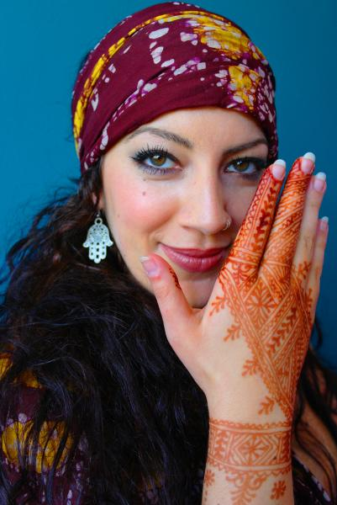
Diversity: special topic research agenda + National Inventory
Graffity and other traditions especially popular with youngsters
Henna and other traditions from diverse communities

Slide 13
Strength of NGOs
With their knowledge and know-how NGOs can help implementing the UNESCO convention and contribute to fruitful government policies concerning ICH and cultural diversity.

