Slide 1
Role and Contribution Of China Folklore Society in Safeguarding Intangible Cultural Heritage in China
Aoqi/ Yang, Lihui/ Zhu,gang

Slide 2
Main Practices of CFS in Safeguarding ICH
Playing a visible role in key projects and programmes at national and local levels
Carrying out theoretical study and developing methodologies for ICH research
Conducting professional practices at regional and international levels
Participation in developing ICH-related policy, regulations and legislation

Slide 3
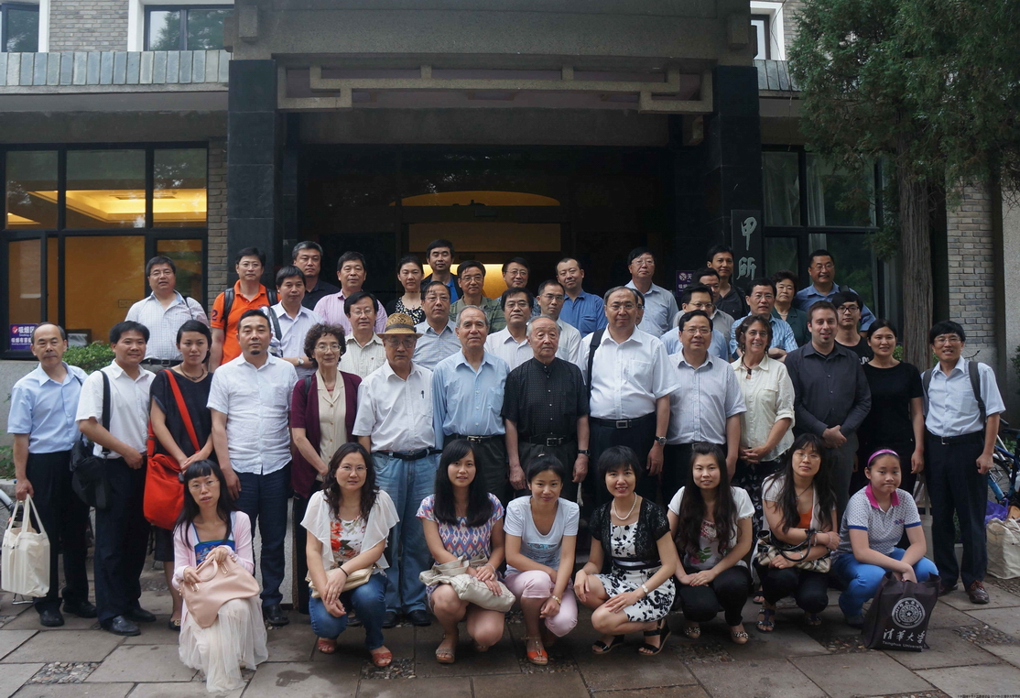
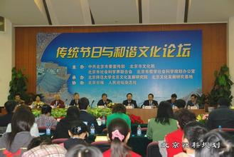
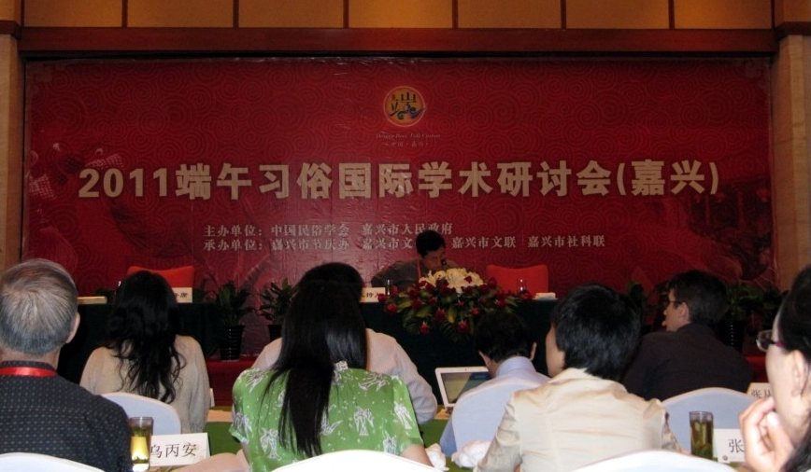
Conferences on Traditional Festivals

Slide 4
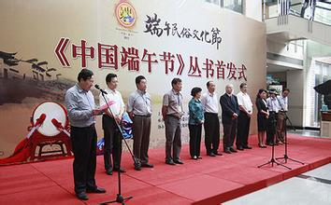
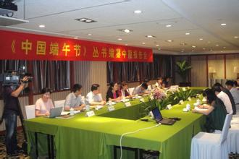
Serial Books on Daunwu Festivals

Slide 5
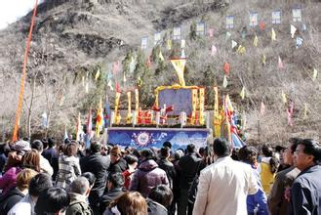
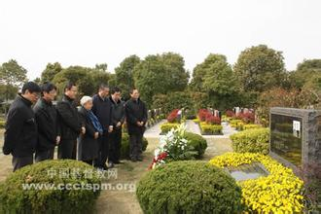
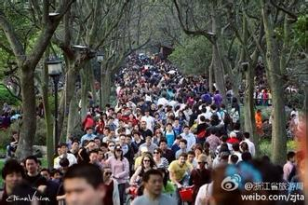
Qingming, or Tomb-sweeping Festival

Slide 6
Conclusions
CFS has been doing its best in safeguarding the ICH, ensuring respect for the ICH, as well as raising respects at the local, national and international levels.
In cooperation with other many organizations at all level, CFS had made considerable impacts on Chinese public policies, legislations, as well as Chinese people’s daily life.
With the efforts of CFS, Chinese people will enjoy a more harmonious and happy life!

