Slide 1
THE ROLES AND CONTRIBUTIONS OF SENA WANGI AS AN NGO IN THE DEVELOPMENT OF PUBLIC POLICIES, LEGISLATION, SAFEGUARDING AND SUSTAINABLE DEVELOPMENT PLANS
By Mr Suparmin Sunjoyo
General Chairman of SENA WANGI
( Indonesian National Puppetry/Wayang Secretariat)

Slide 2
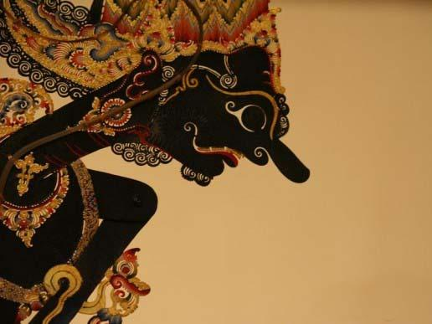
SENA WANGI
SENA WANGI, established in 1975 continuing its activities to preserve, develop & safeguard its programs. Coordinating : PEPADI, APA, UNIMA Indonesia, PEWANGI, sanggars (traditional institutions), good co-operation with Government Institutions: Directorate General of Culture-Ministry of Education & Culture, ISI Surakarta, ISI Yogyakarta, STSI Bandung, STSI Denpasar etc.
Keeping in the right direction, at the 8th SENA WANGI Congress on 20-22 October 2011, a Strategic Development Plan of Wayang/Puppetry of 2010-2030 was promulgated.

Slide 3
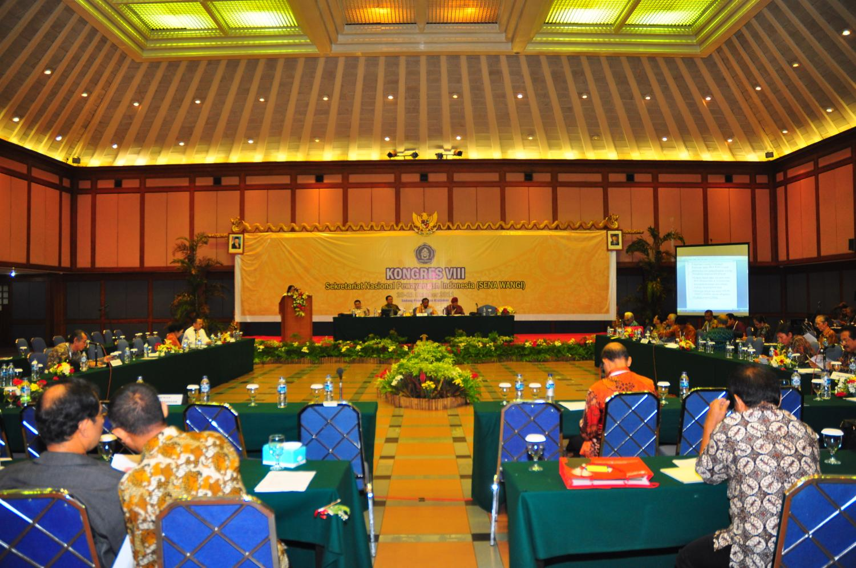
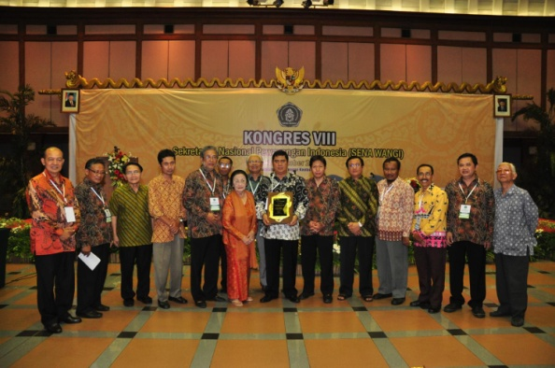
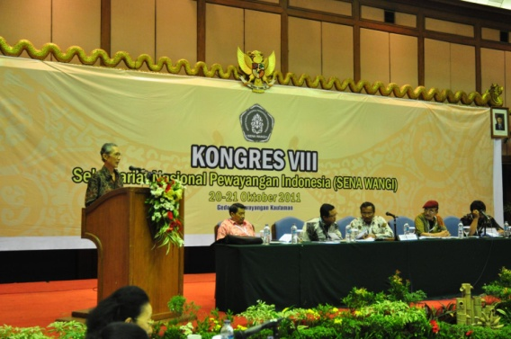
8th SENA WANGI Congress Jakarta, 20-22 October 2011

Slide 4
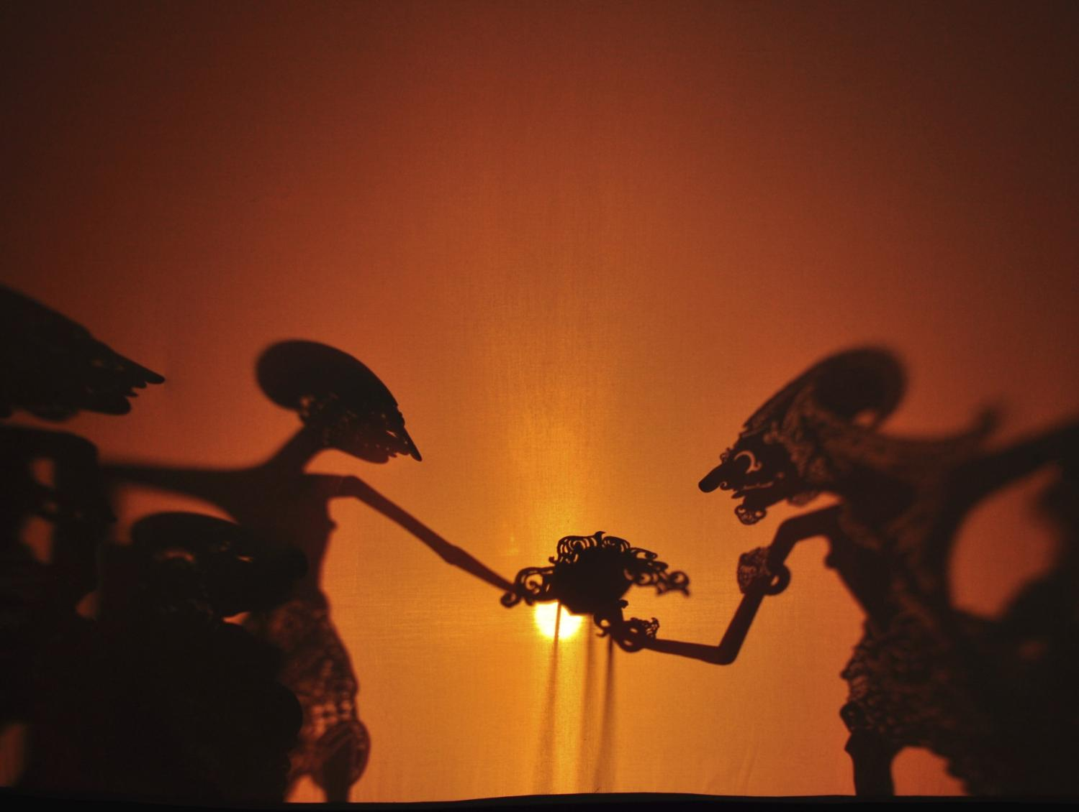
PUBLIC POLICIES
In co-operation with Faculty of Philosophy – Gadjah Mada University, Institute of Arts-Yogyakarta and Surakarta have formulated a Wayang Philosophy, a new branch of study at Gadjah University, still being socialized to other institutions.
With Indonesian Institute of Arts-Surakarta and Malang State University a book entitled: Pendidikan Budi Pekerti Dalam Pertunjukan Wayang=Good Conducts in Wayang Performances–has been published and disseminated to various institutions.

Slide 5
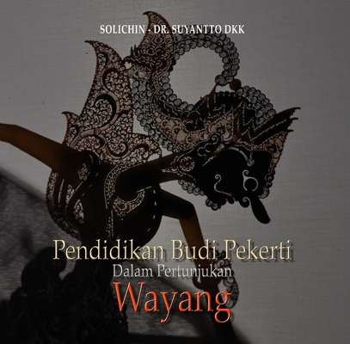
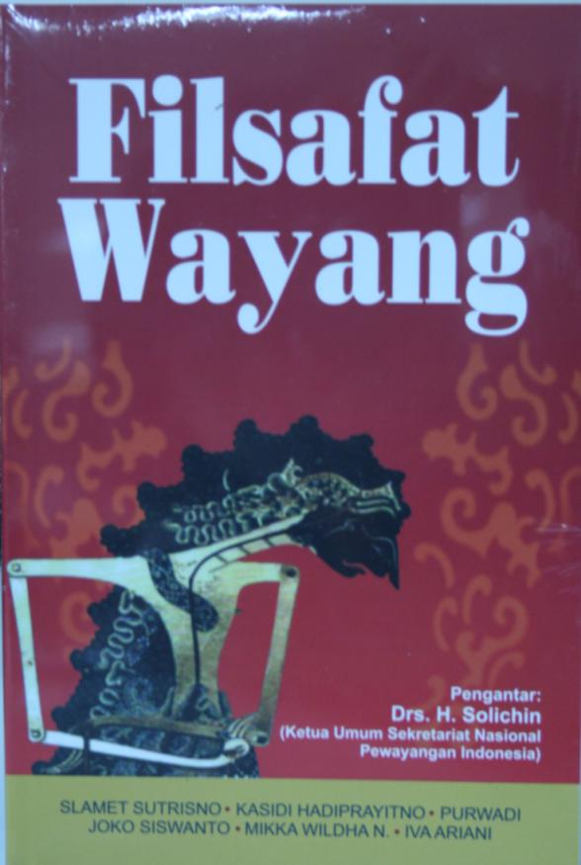
Good conducts in Wayang Performance
Wayang Philosophy

Slide 6
Scientific Aspects of Wayang

Slide 7
LEGISLATION
Convention For The Safeguarding Of The Intangible Cultural Heritage, Paris 17 October 2003 had been ratified by the President on 5 July 2007 stipulating the enactment of Convention for the Safeguarding Measures and Sustainable Development.
Through Ministry of Education and Culture, relevant materials on puppetry to be included in the school curriculum; also subjects on preserving traditional arts and culture in which puppetry is one of the contents through Parliament be proposed for legislation.

Slide 8
SAFEGUARDING MEASURES AND SUSTAINABLE DEVELOPMENT
Long-Term Strategic Plan of Indonesian Wayang Development of 2010-2030.
Publishing books: Ensiklopedi Wayang Indonesia, and 10 different ones, and those are still in the process of composing while inserting new entries into Ensiklopedi Wayang Indonesia, to be issued in 2015 also: Pentas Wayang Dunia/World Wayang Performances-int’l puppetry festival in Jakarta, 2013.
Regular festivals: FWI, FDB, FDM, abroad: UNIMA and ASEAN Puppetry Association (APA), the requests of Indonesian missions overseas.

Slide 9
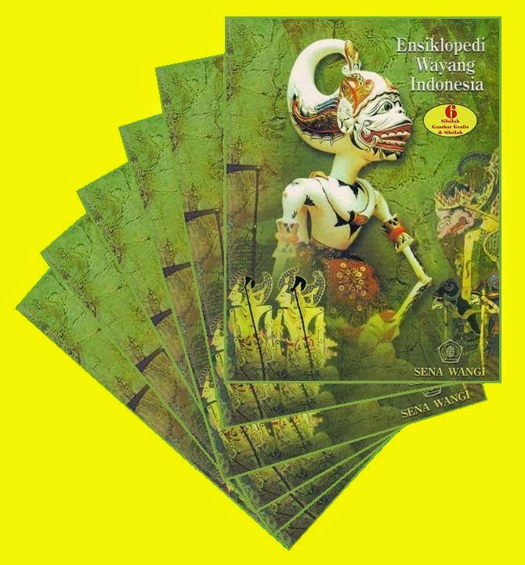
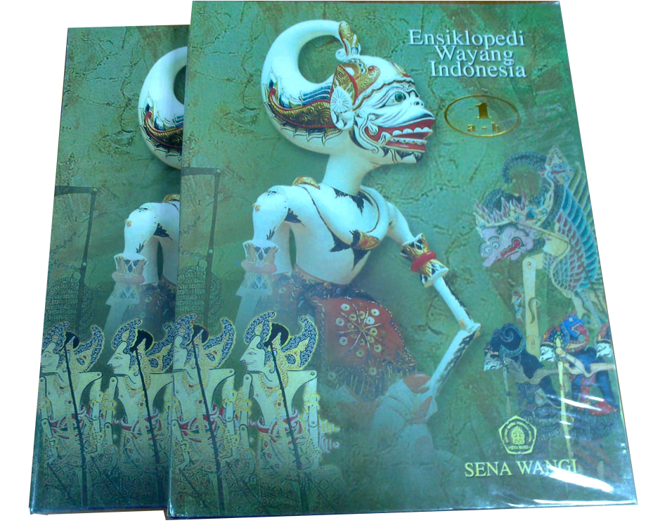
Encyclopedia of Indonesian Wayang

Slide 10
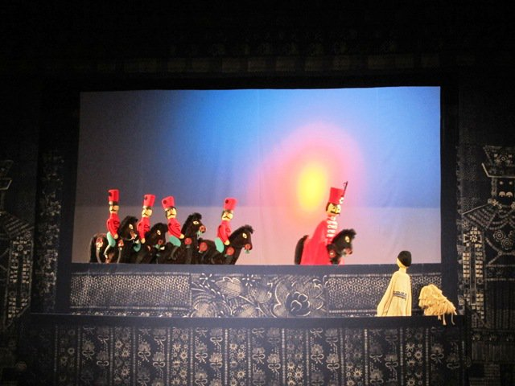
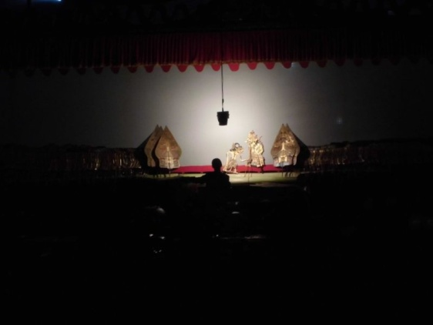
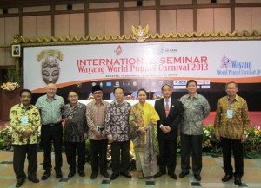
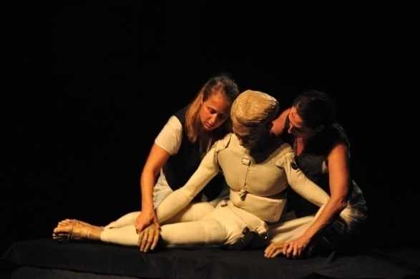
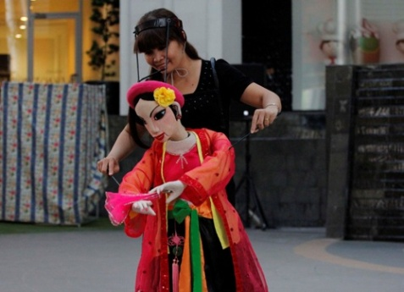
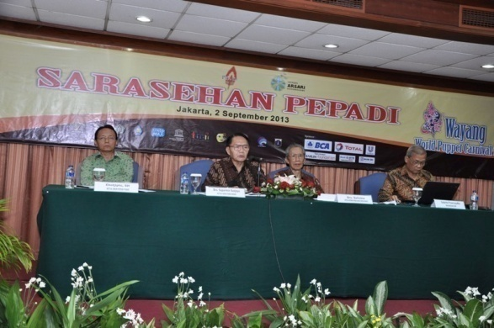
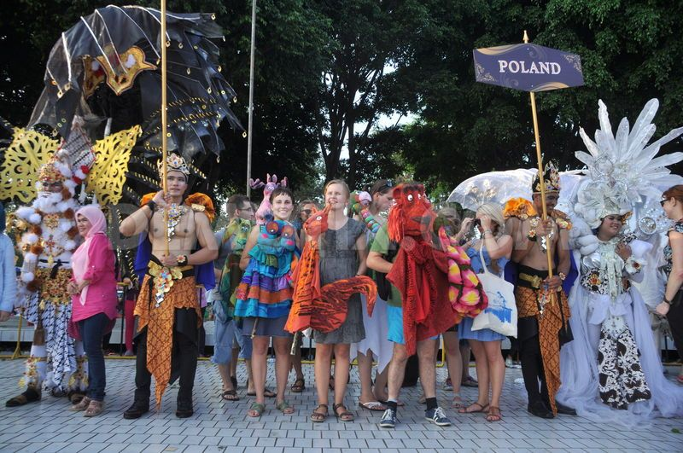
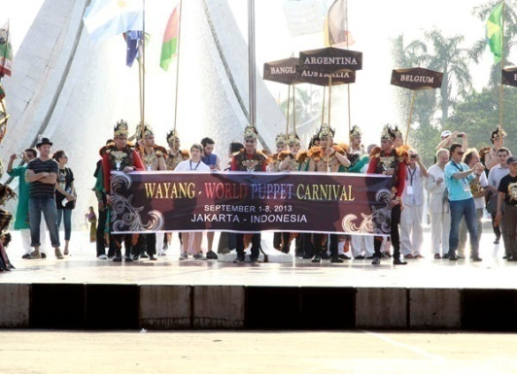
Wayang World Puppet Carnival Jakarta, 1-8 September 2013

Slide 11
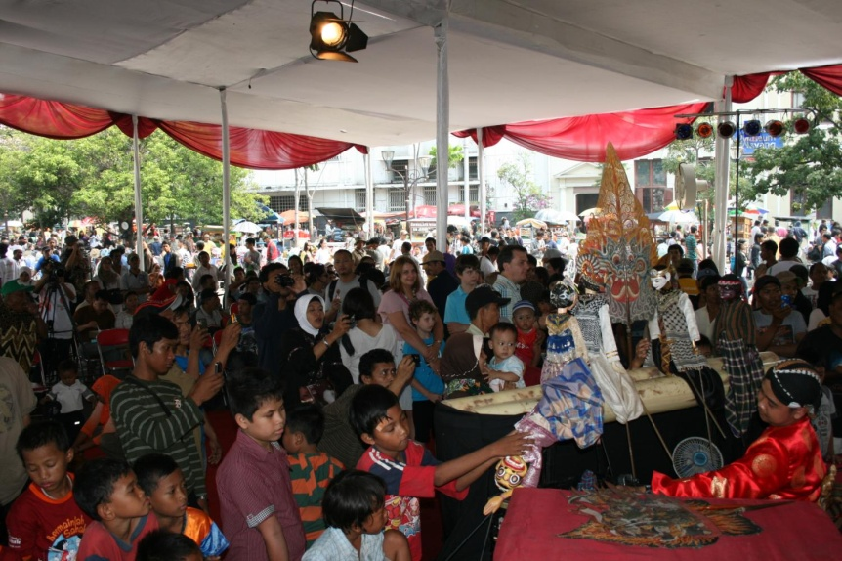
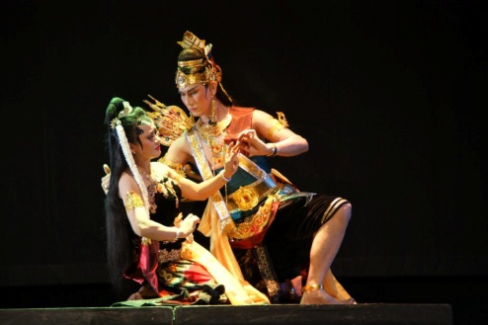
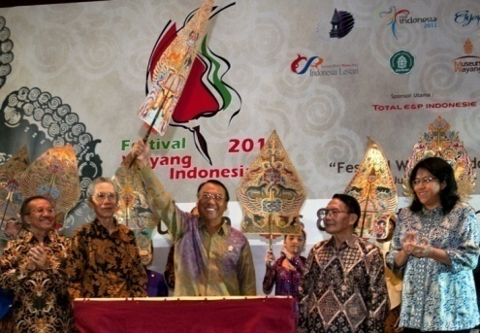
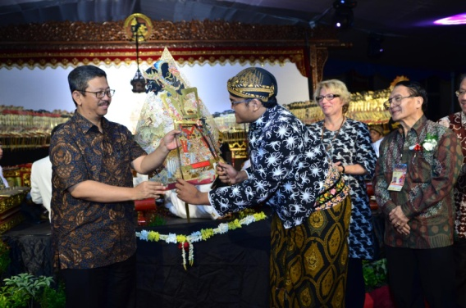
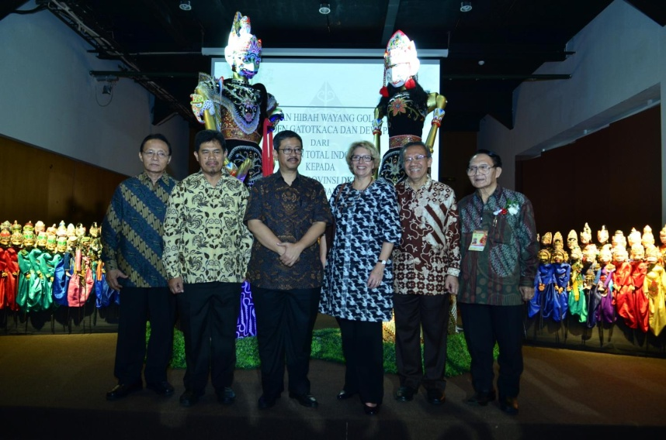
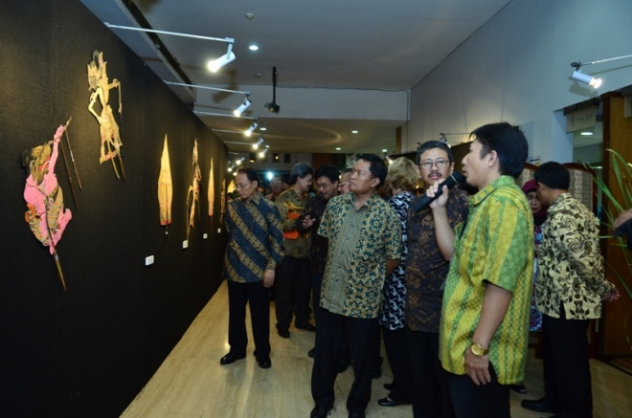
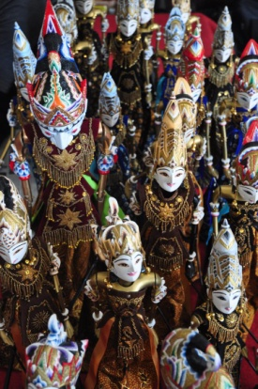
Indonesian Wayang Festival Annual event : Seminar, Exhibition, workshop, discussion on newly published books on wayang and performances of many varieties of wayang

Slide 12
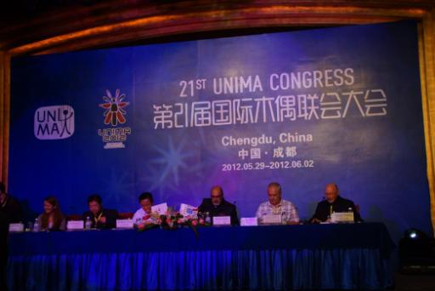
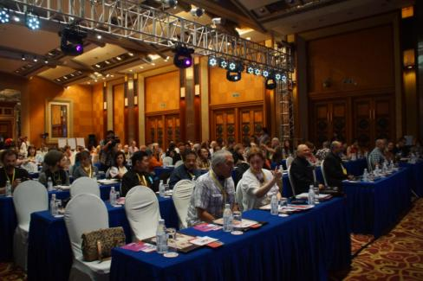
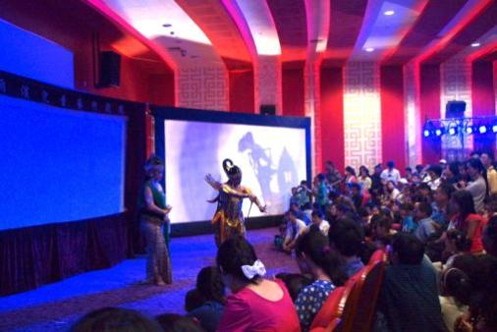
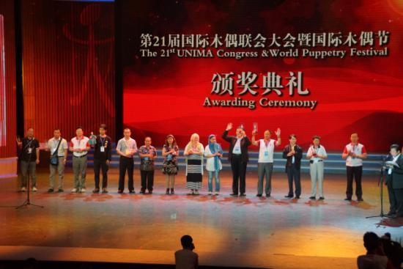
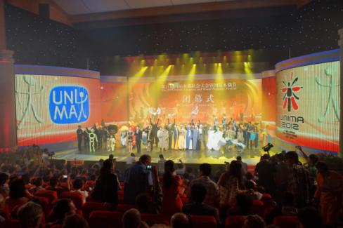
Participation in UNIMA

Slide 13
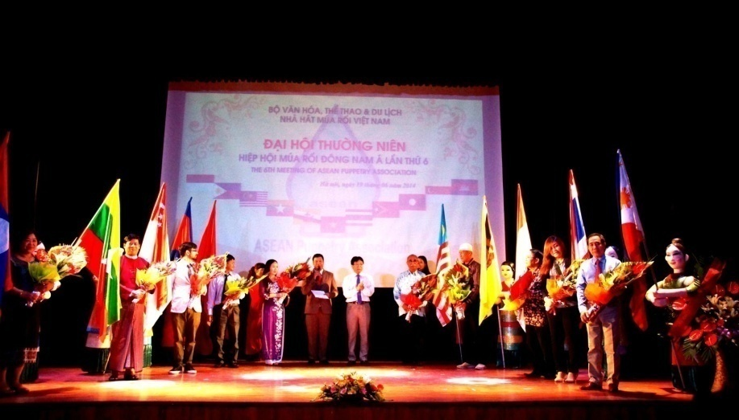
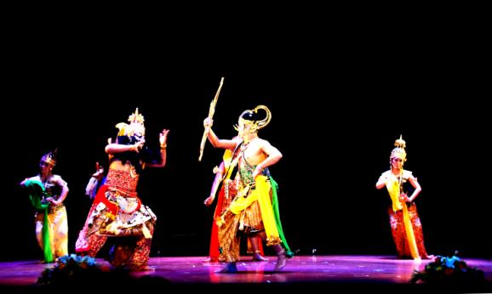
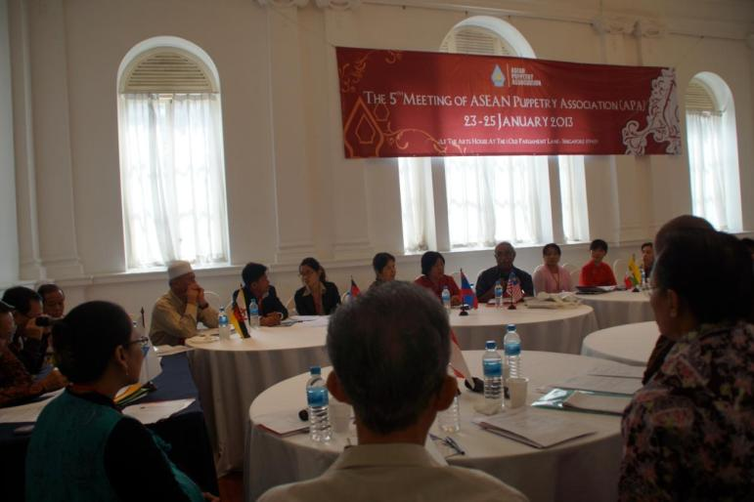
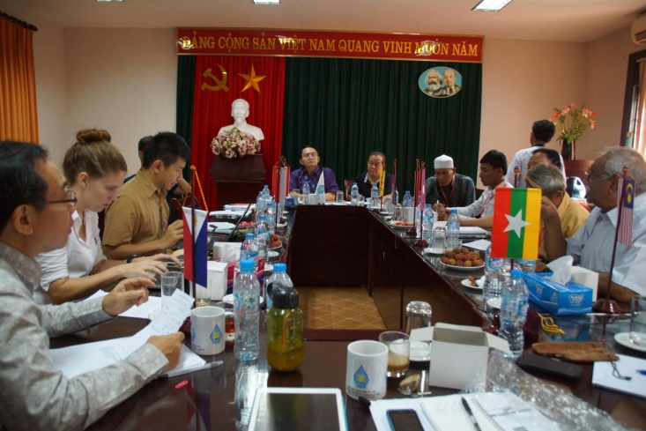
Participation in ASEAN Puppetry Association

Slide 14
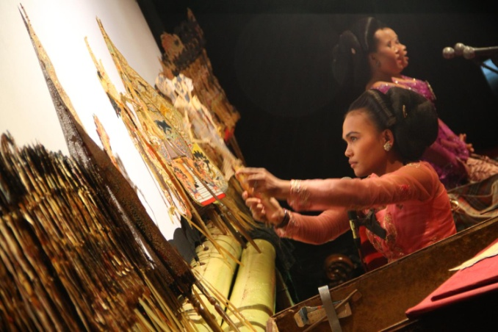
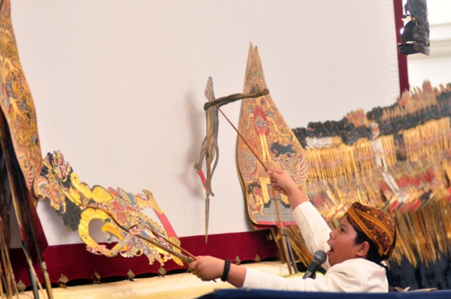
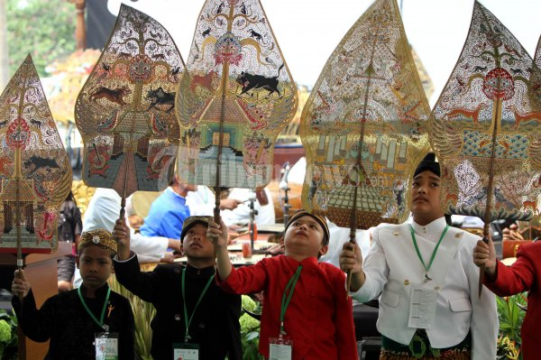
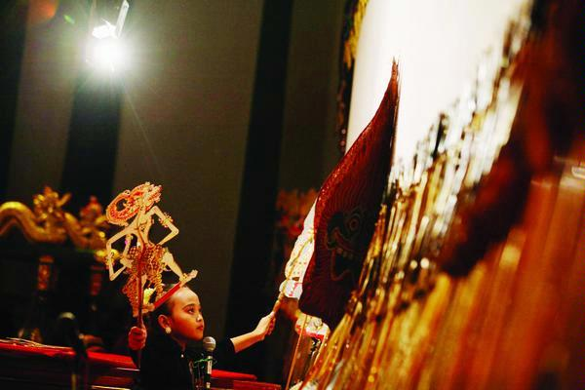
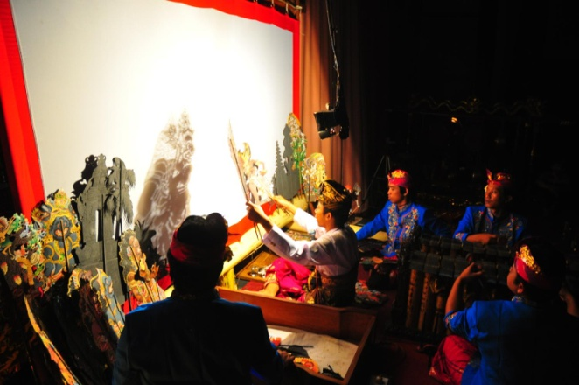
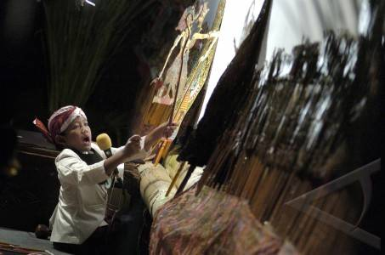
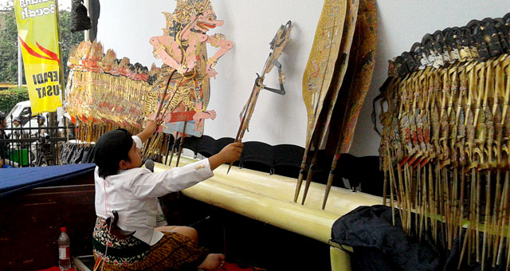
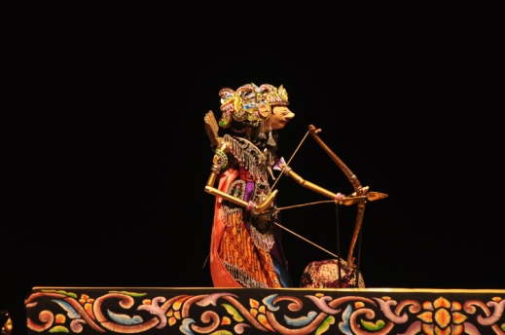
Young Boy and Girl Puppeteers in Action

Slide 15
THANK YOU

