Slide 1
Interaction between Government and NGOs
by Gaura Mancacaritadipura
(Indonesian National Kris Secretariat – SNKI)
Presented at NGO Forum Symposium, Paris, 23 Nov 2014

Slide 2
Interaction between Government and NGOs
The Vice-Minister of Culture of Indonesia has made it a point to identify, meet with, and have ongoing communication with, NGOs and community members related to elements of Indonesia’s ICH which have been inscribed on or nominated for the lists established under the 2003 Convention.
This is because the Ministry understands the important roles these NGOs and community members play in ongoing safeguarding of these elements of ICH. The NGOs in particular are understood to serve as bridges between the government and ICH communities, which in many cases may be spread very widely over the country.

Slide 3
Practical Functions of Indonesian NGOs
Participation in drafting of nomination files (eg. Indonesian Wayang
Execution of Safeguarding Action Plans and periodic reporting (eg. SENA WANGI, SNKI, Angklung Music Society, Papua Ecology Institute, Batik Foundation)
Collaboration with the government for holding big events for ICH awareness raising, safeguarding, etc.
Participation in UNESCO Meetings

Slide 4
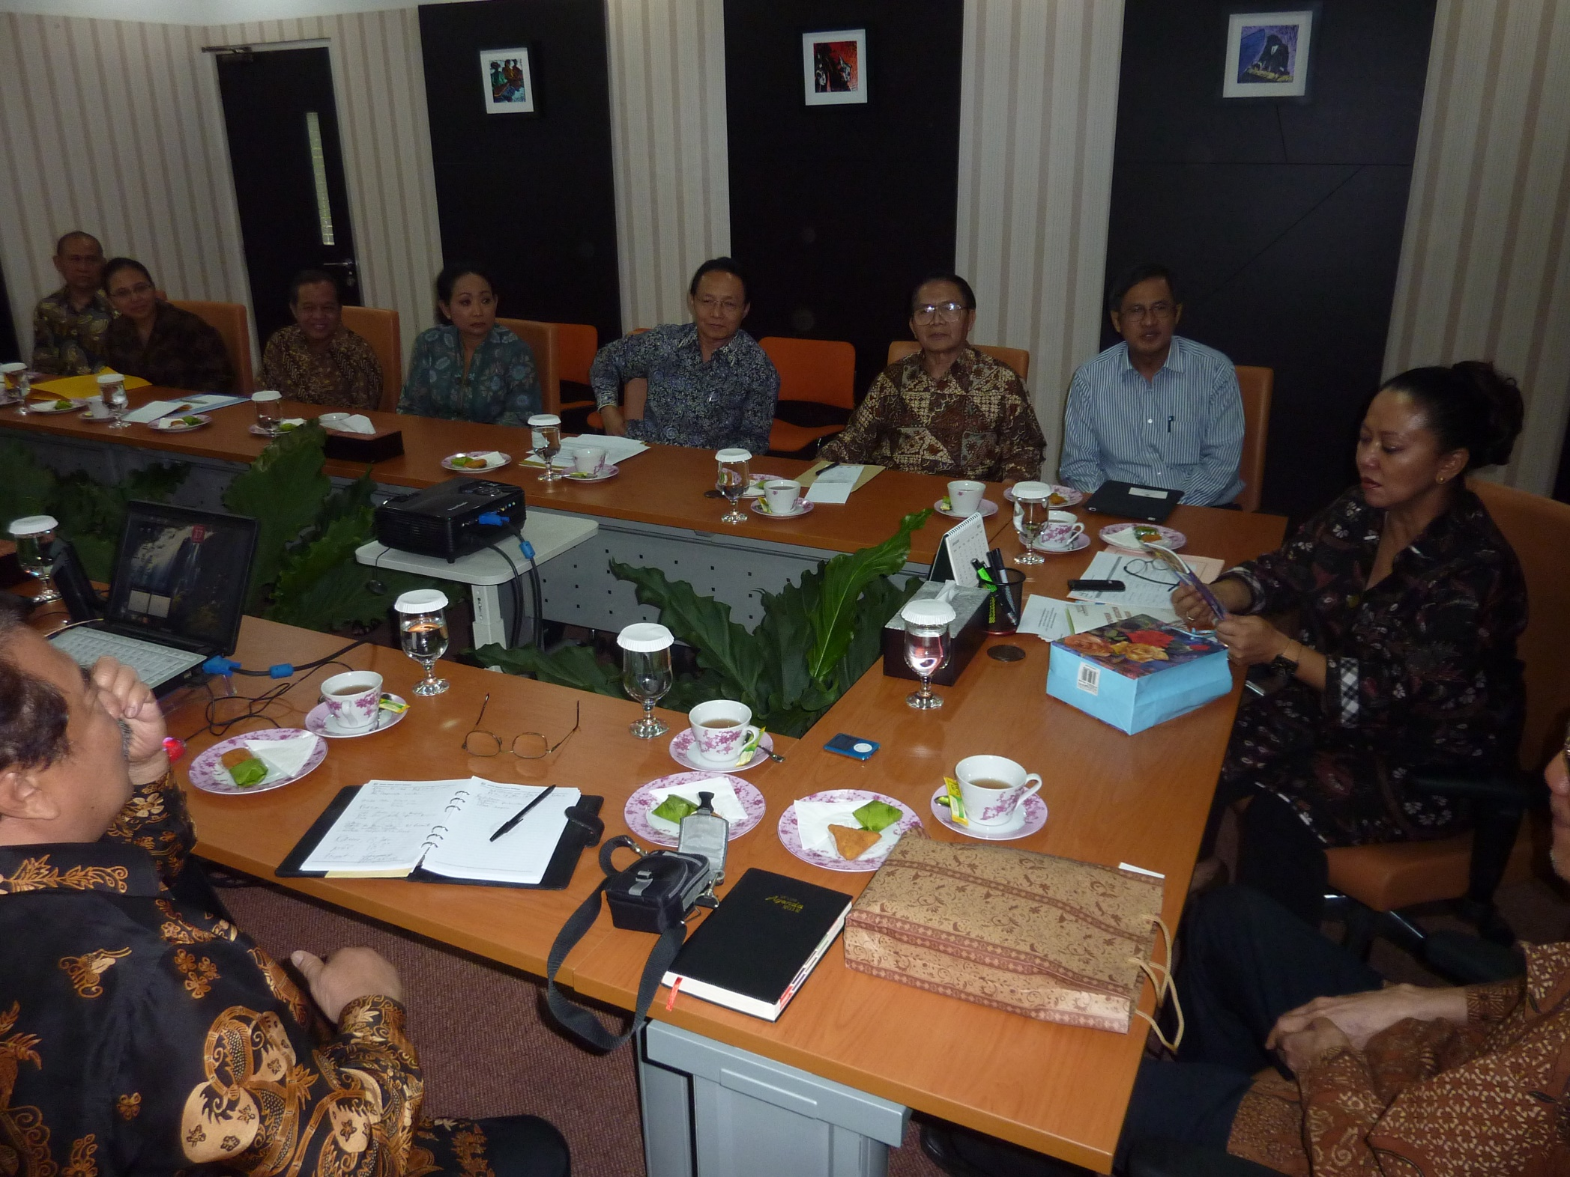

Slide 5
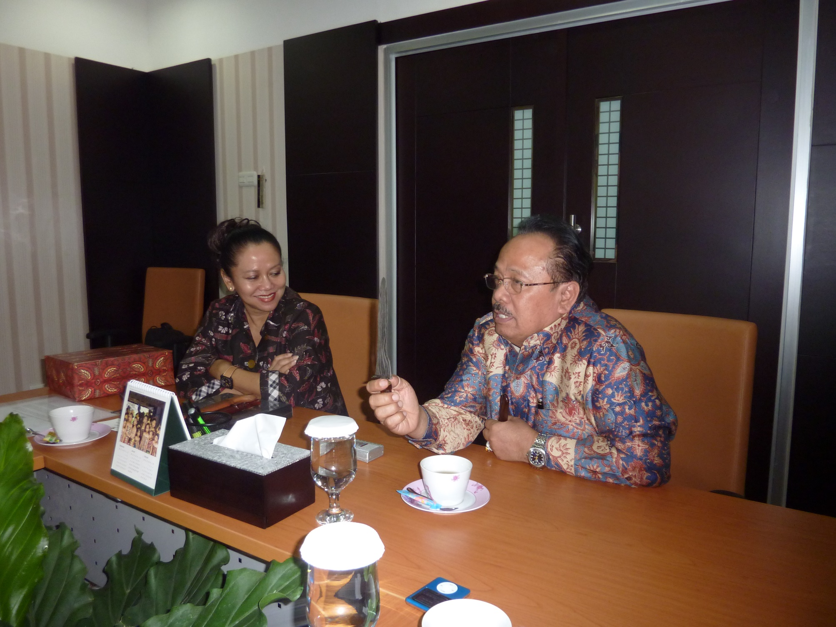

Slide 6
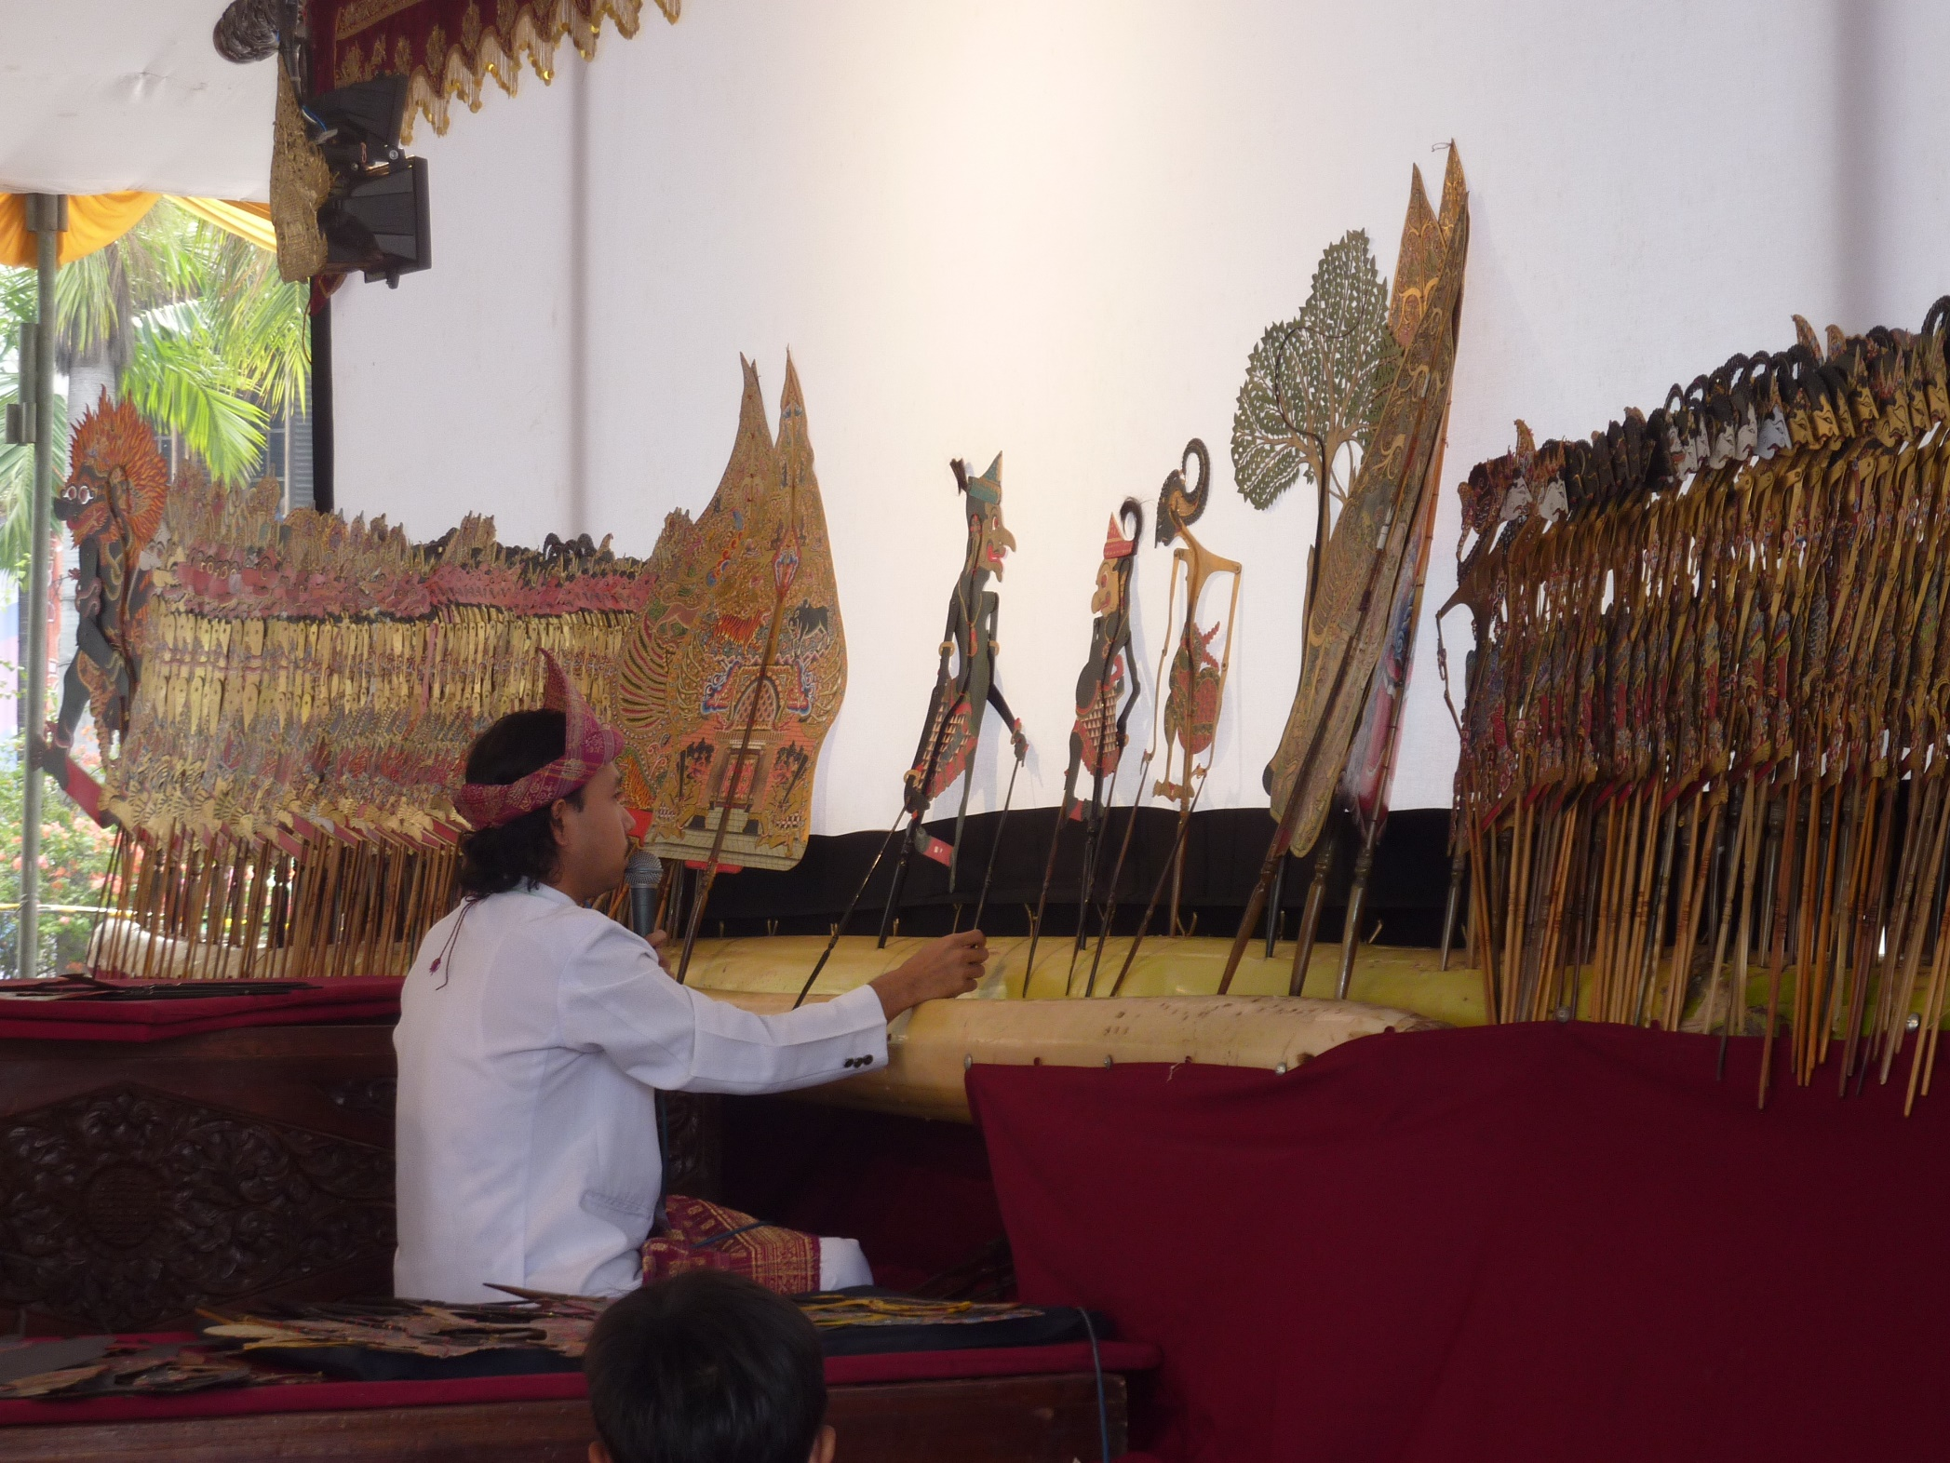

Slide 7
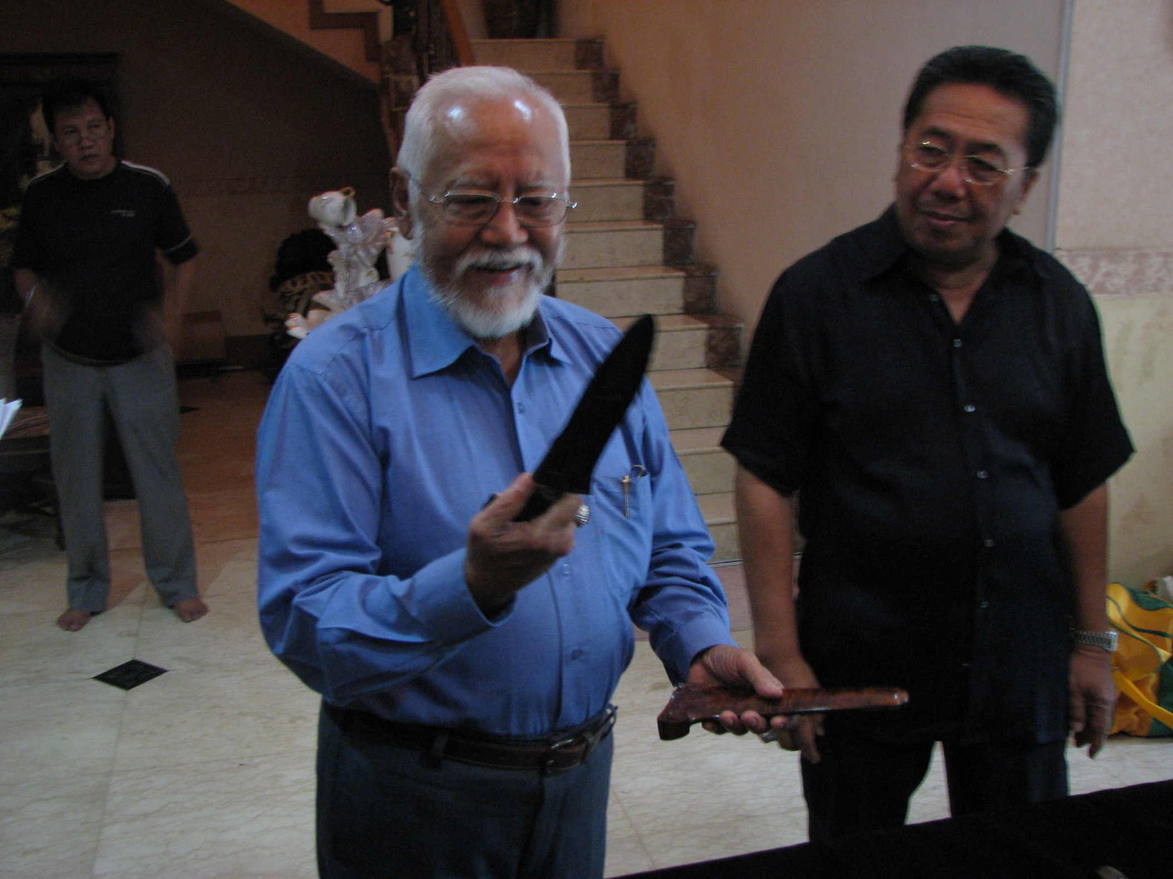

Slide 8
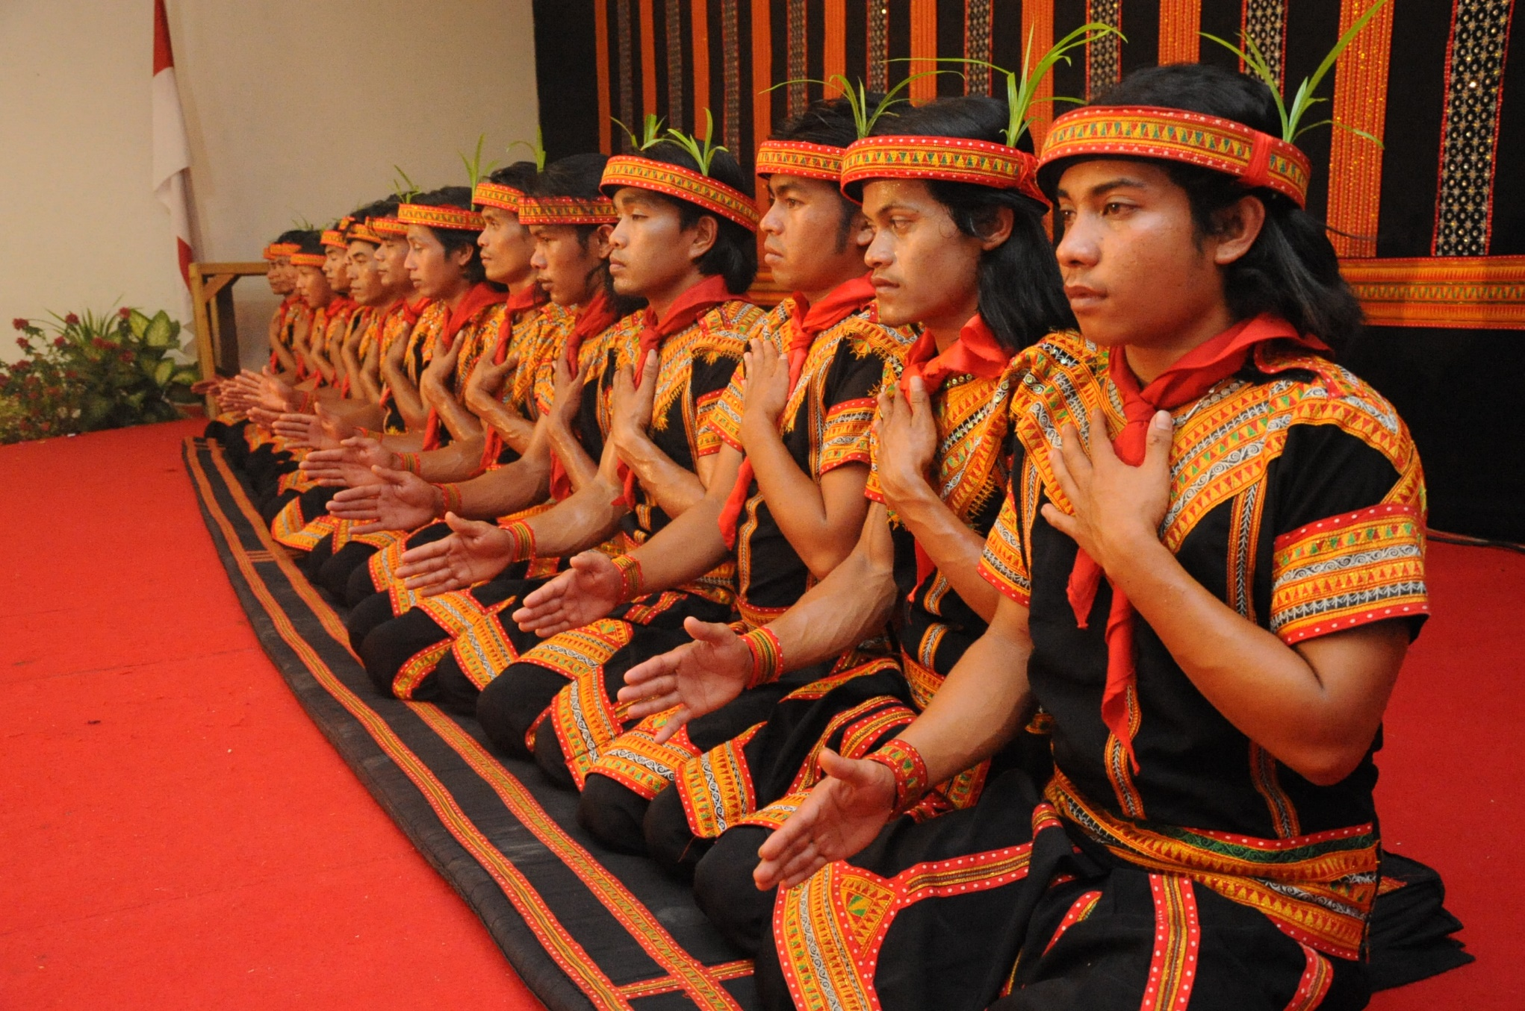

Slide 9
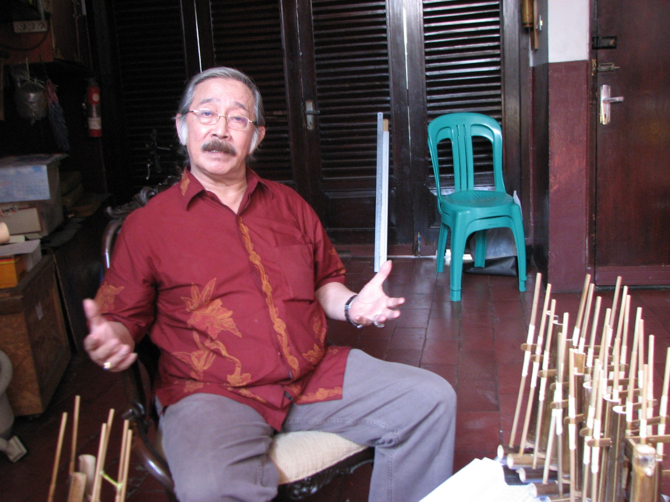

Slide 10
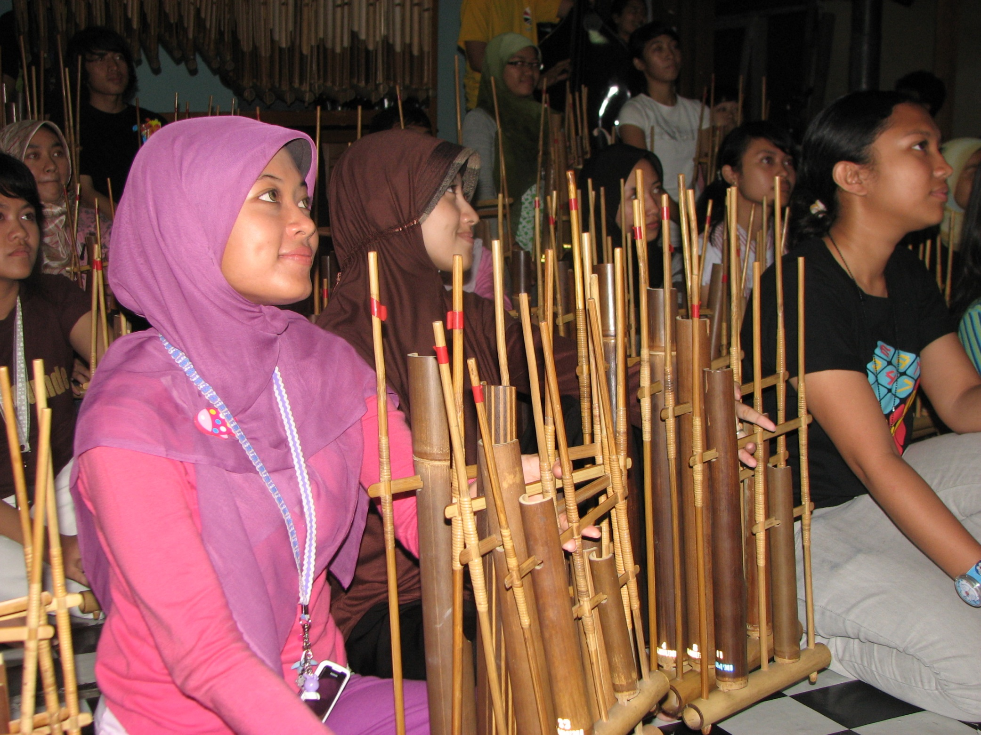

Slide 11
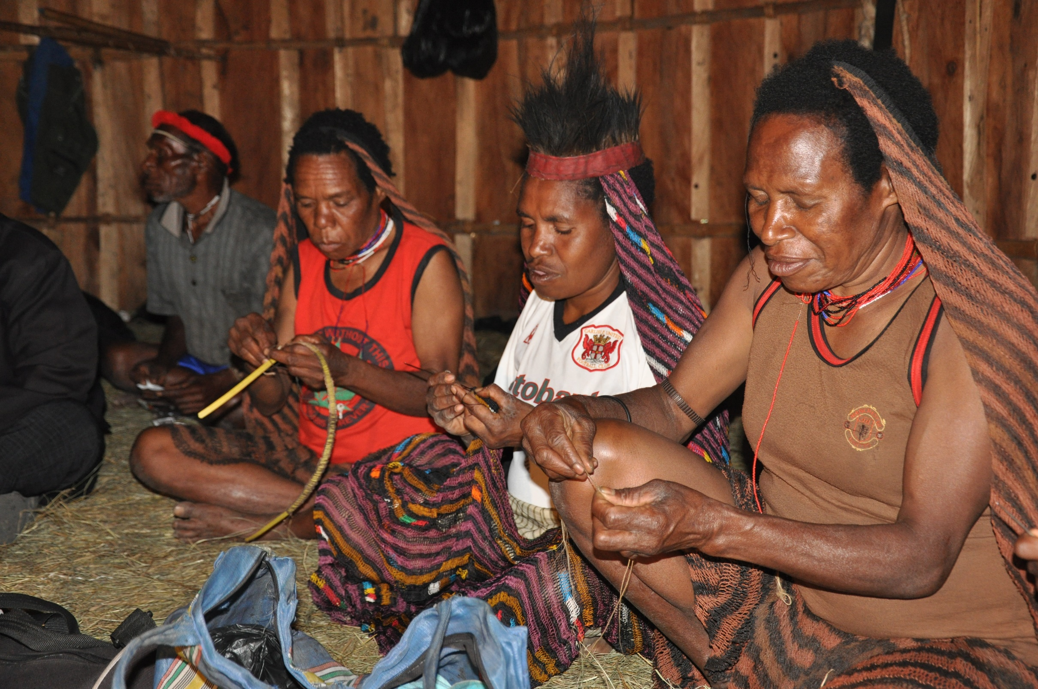

Slide 12
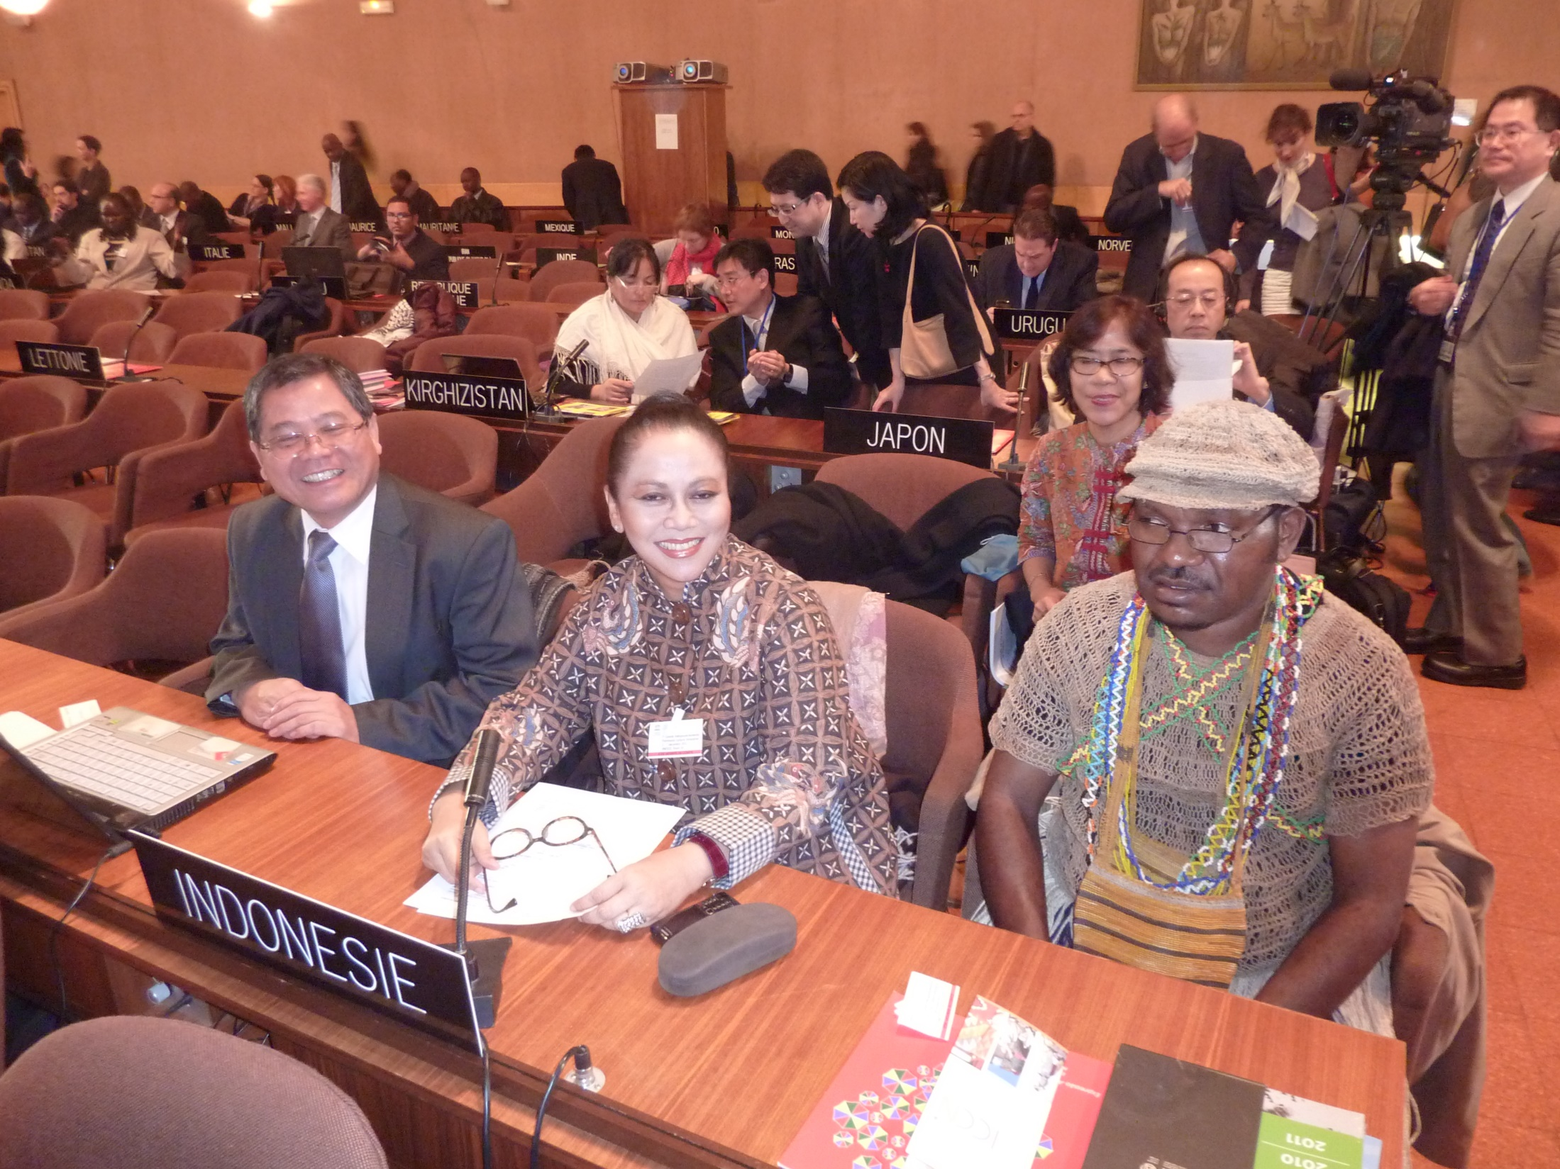

Slide 13
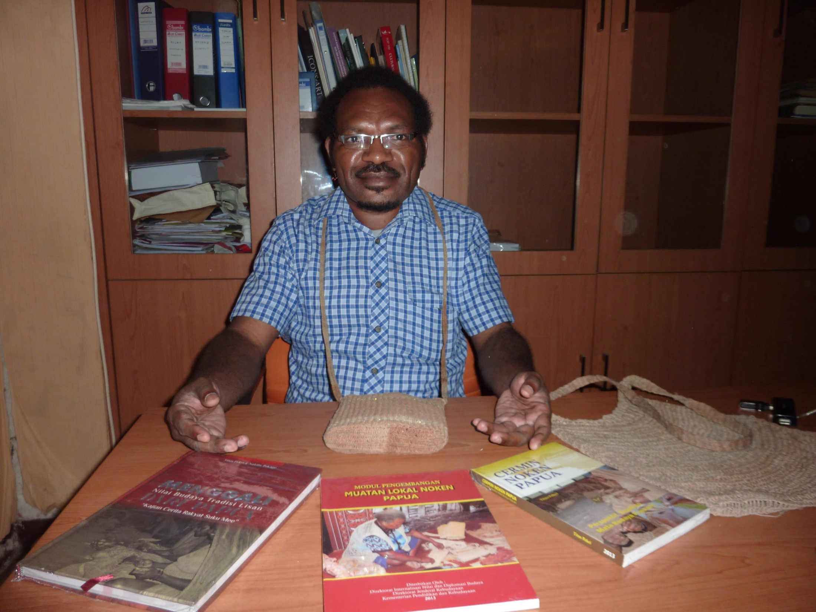

Slide 14
Conclusion
NGOs play an essential role as interfaces between governments and communities
NGOs play two vital roles under the 2003 Convention; namely 1. Safeguarding, and 2. Advisory/Consultative eg. Participating in Evaluating Body
In Indonesia NGOs have participated in drafting nomination files, execution of safeguarding action plans and periodic reports, and organization of ICH events
Thank you/ Merci beaucoup

