Slide 2
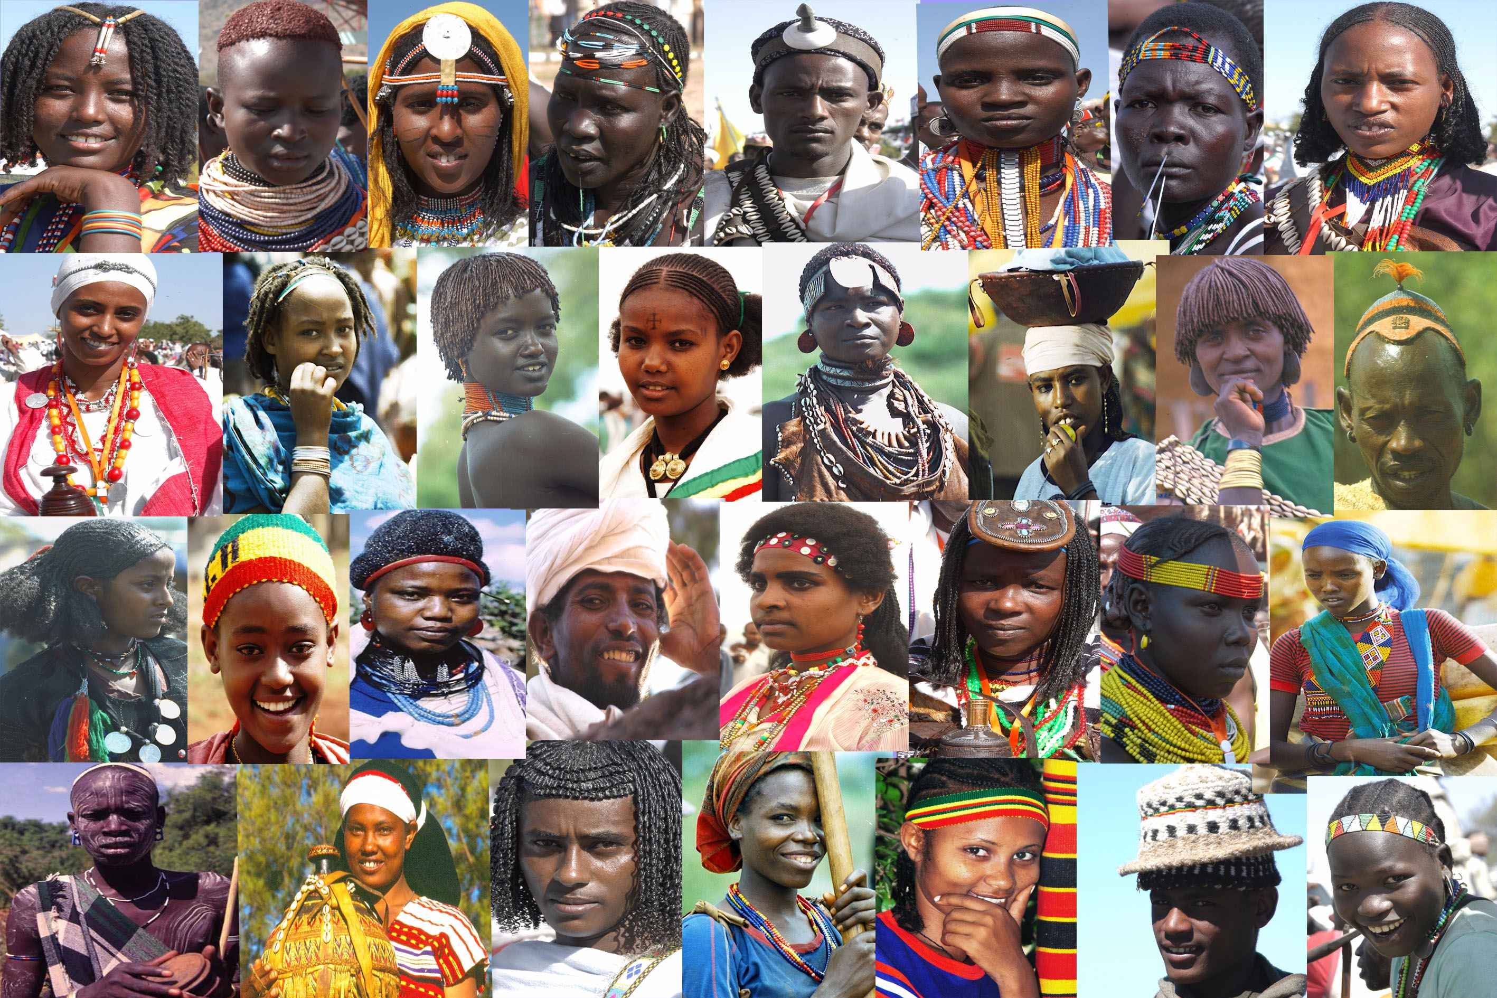
Mosaic of Peoples and Cultures, Ethiopia is very happy to host the 11th session of the Intergovernmental Committee for the Safeguarding of the Intangible Cultural Heritage

Slide 3
2013: Inscription of the Commemoration feast of the finding of the True Holy Cross of Christ in the Representative List of the Intangible Cultural Heritage of Humanity
2015: Inscription of Fichee-Chambalaalla, the celebration of New Year festival of the Sidama people in the Representative List of Intangible Cultural Heritage of Humanity

Slide 4
Meskel Celebration

Slide 5
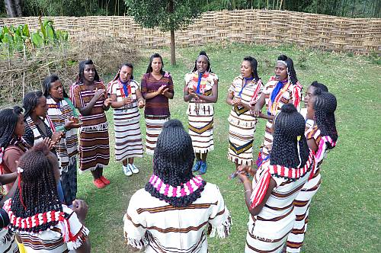
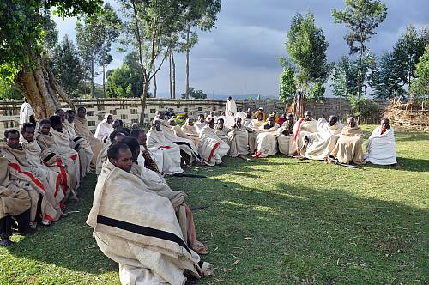
Fichee Chambalaalla celebration

Slide 6
Key Facts about Ethiopia
Territory of 1,104,300 km2, 10th largest country in Africa.
About 100 million population, the 2nd largest in Africa (after Nigeria) and the world’s 13th populous country
A federal State composed of nine Regional States and two City Administrations
88 Languages and dialects are spoken
Official language: Amharic
Currency: €1≈ 25Birr 1USD ≈ 22Birr
9 world Heritage Sites

Slide 7
Temperature: 14 °C 28 °C
The City ranges from 2,200m to 2,600m
About 5 million inhabitants
Capital city Addis Ababa

Slide 8
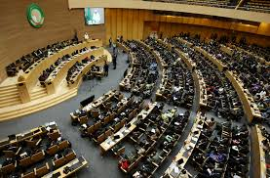
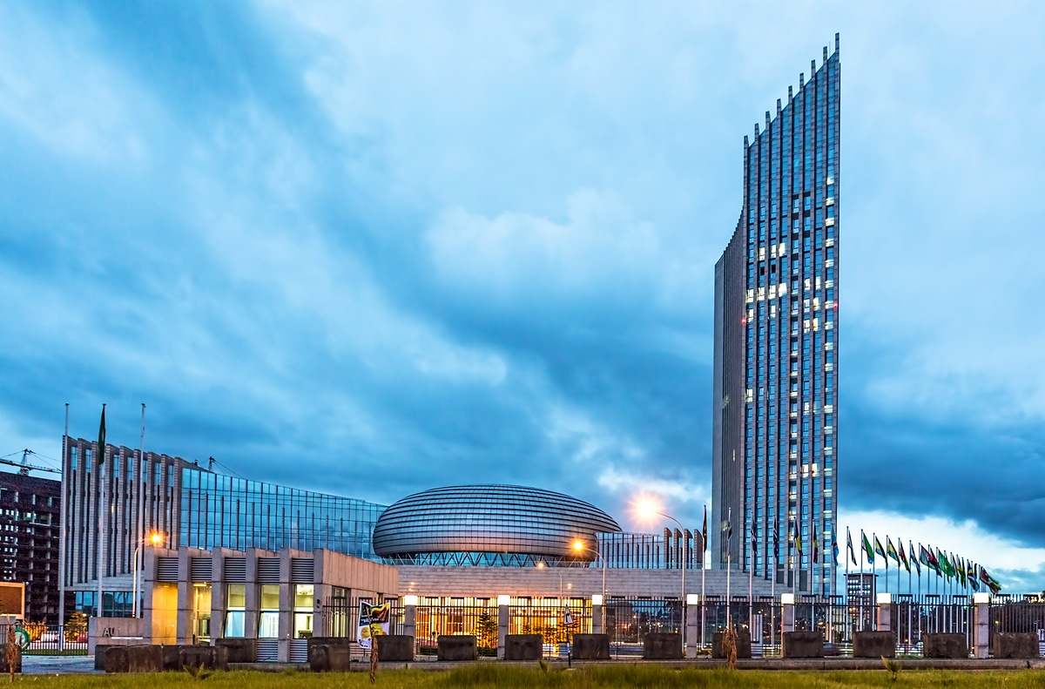
28 November – 2 December 2016 at the African Union Conference Centre

Slide 9
Travelling to Addis-Ababa
For a complete list of international and domestic offices and call centers, see www.ethiopianairlines.com

Slide 10
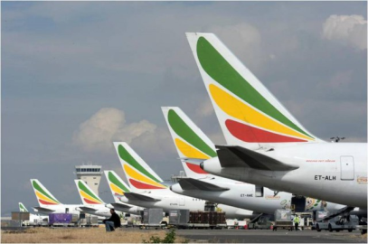
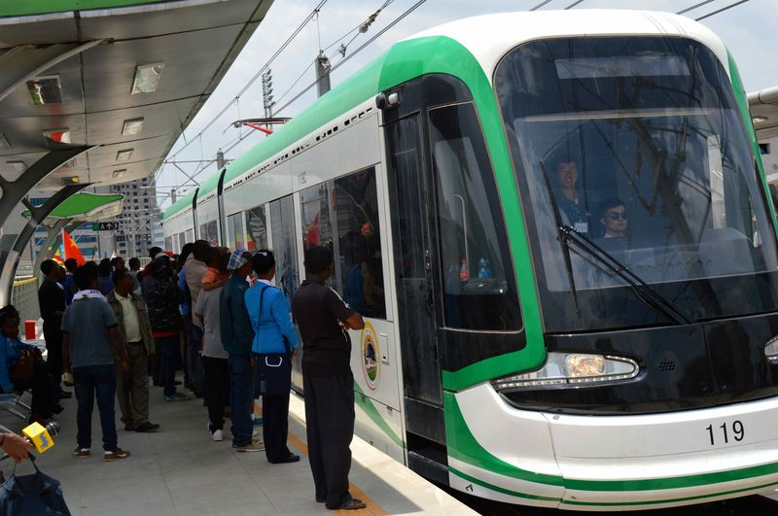
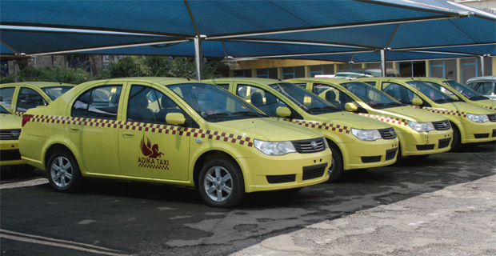
Logistics
VISA
Must be obtained from the Ethiopian Embassy or Consulate in the area of your residence
Visa Upon Arrival at Bole International Airport will be facilitated for participants coming from areas where there is no Ethiopian Embassy or Consulate
Contact person: Mrs Tsehay Eshetie Alternate: Mrs Feven Tewolde
Tel: 0025191142150
Email: tsehayeshe@yahoo.com f.tewolde.et@unesco-delegations.org

Slide 11
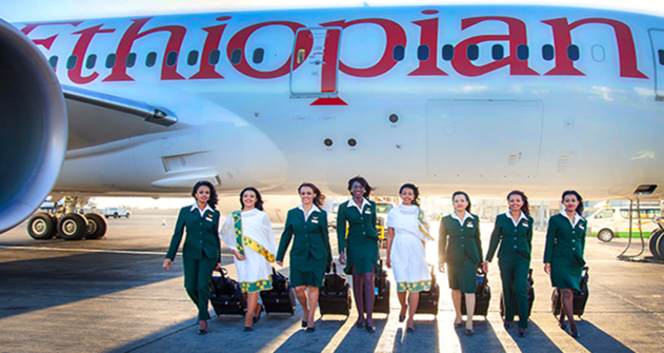
The largest Airline in Africa,Ethiopian Airlines, is happy to offer you a 15% discount

Slide 12
Practical information: arrival
Welcome desk at Bole International Airport from November 25 to 4 December 2016
Shuttle buses from Bole International Airport to respective hotels
Registration desk at the African Union Conference Centre as from 26thof November
Participants are encouraged to register and receive the badges at the earliest possible
Conference bags will be available at registration

Slide 13
Practical information: transports and venue
A list of approved Hotels available at the ICH website
Shuttle buses from hotels to meeting venue and the other way during the meeting
Delegates will be welcome to stay elsewhere, but need to make own transport arrangement
In the plenary session hallseats will be allocated for each delegation (capacity of 3000 people)
Opening Ceremony: Sunday 27 November at 05:00pm in the Millenium Hall
Closing Ceremony: Friday 2 December time and place to be communicated

Slide 14
A Quick Gateway in the land of breathtaking scenic variety and rich biodiversity
More information on: http://www.ethiopia.travel/

